Slide 1

Vocabulary

Slide 2
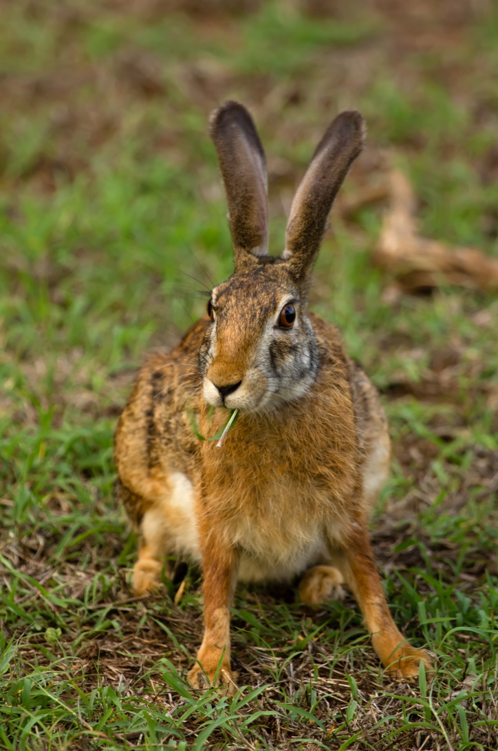
HARE

Slide 3
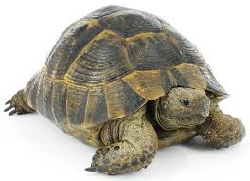
TORTOISE

Slide 4
OTHER ANIMALS FROM the STORY

Slide 5
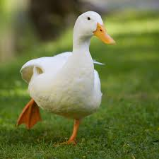
DUCK

Slide 6
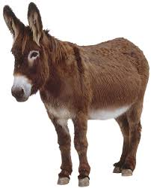
DONKEY

Slide 7
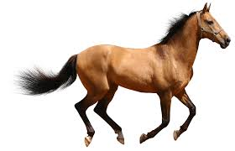
HORSE

Slide 8
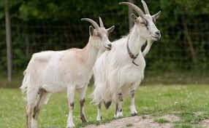
GOAT

Slide 9
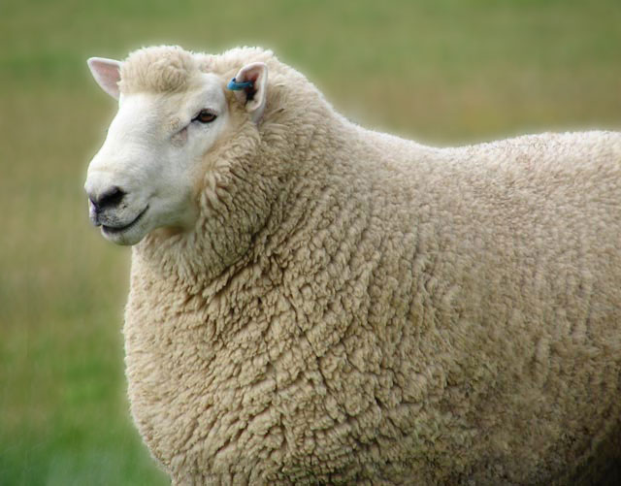
SHEEP

Slide 10
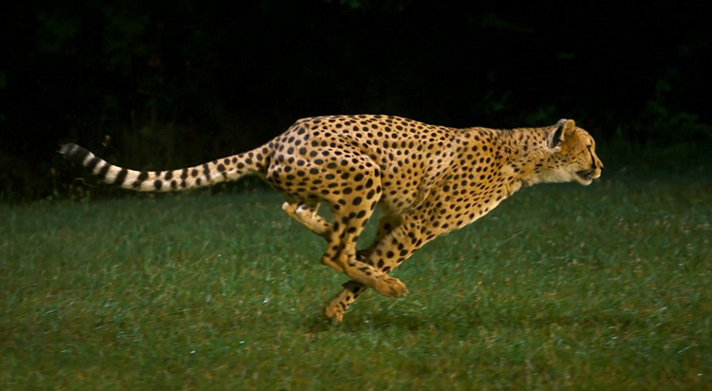
FAST

Slide 11
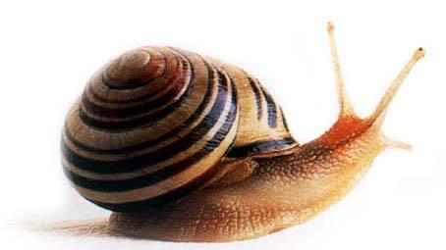
SLOW

Slide 12
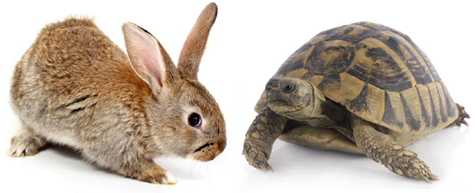
THE HARE AND THE TORTOISE

