Slide 1
What am I?
Chapter 3 Storyfun for Starters

Slide 2
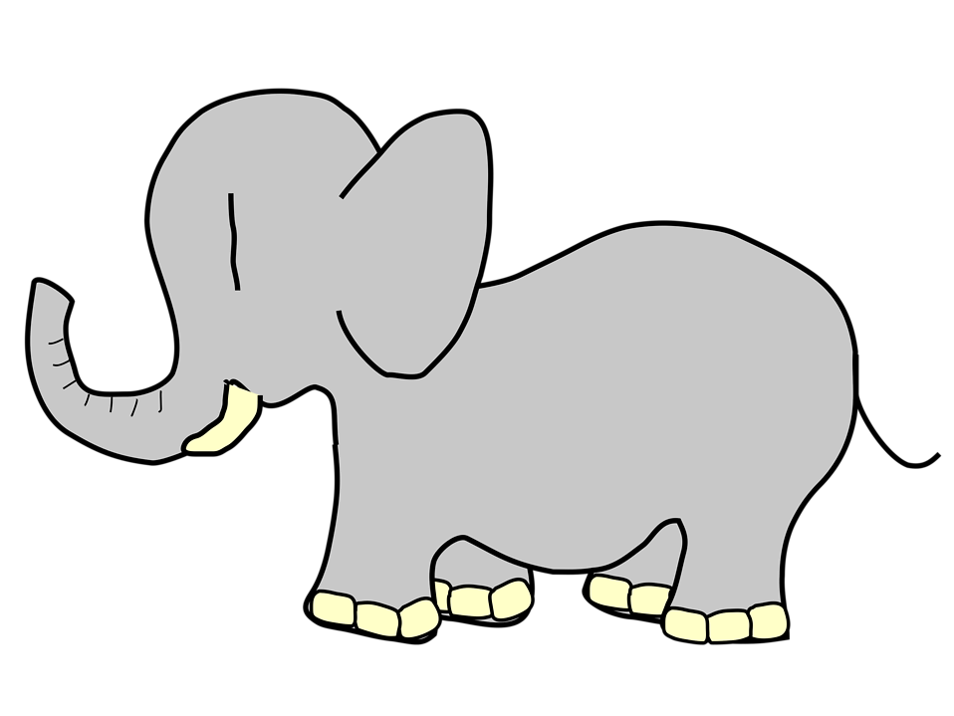
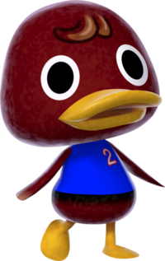
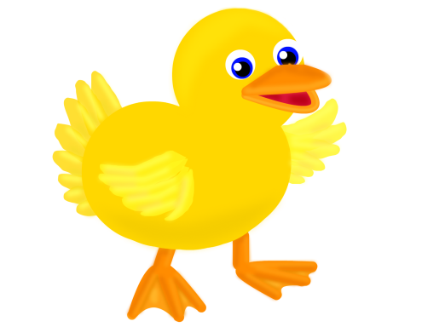
The Duck and the Elephant

Slide 3
The duck asks the elephant.
Excuse me!
What am I?
Can you tell me?

Slide 4
The elephant answers the duck.
Well, you aren´t an elephant.
I´m an elephant.

Slide 5

The Duck and the Crocodile

Slide 6
The duck asks the crocodile.
Excuse me!
What am I?
Can you tell me?

Slide 7
The crocodile answers the duck.
Well, you aren´t a crocodile.
I´m a crocodile.

Slide 8
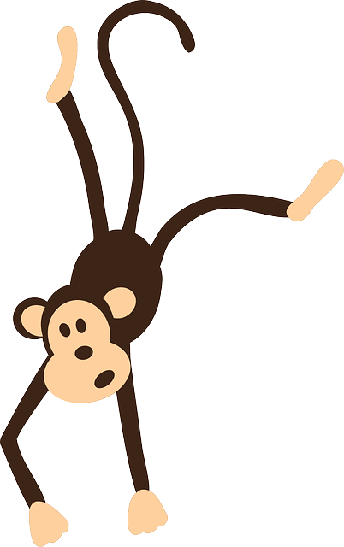
The Duck and the Monkey

Slide 9
The duck asks the monkey.
Excuse me!
What am I?
Can you tell me?

Slide 10
The monkey answers the duck.
Well, you aren´t monkey.
I´m a monkey.

Slide 11
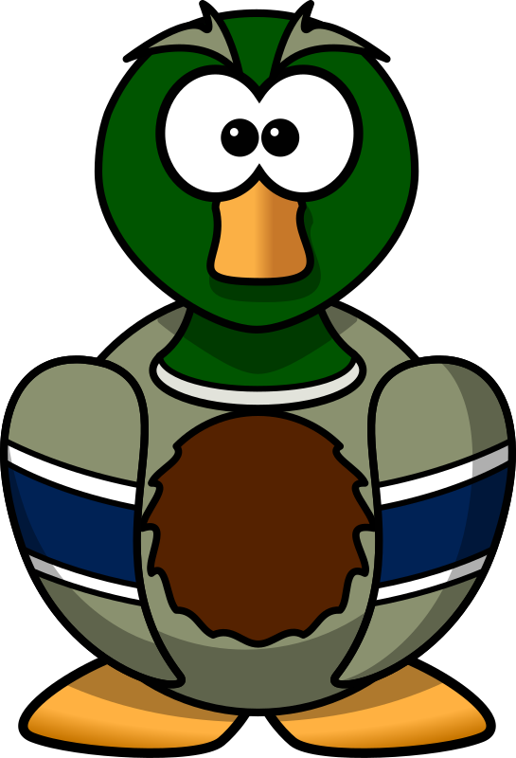
The Duck and the Duck

Slide 12
The duck asks the elephant.
Excuse me!
What am I?
I´m not an elephant. I´m not a crocodile and I´m not a monkey.
Can you tell me?

Slide 13
The elephant answers the duck.
You´re a duck like me!

Slide 14
What am I?
My body is very big.
I have got big ears.
What am I?

Slide 15
What am I?
My body is very big.
I have got big ears.
What am I?
I´m an elephant.

Slide 16
What am I?
I´ve got lots of long white teeth.
I´ve got a long tail.
What am I?

Slide 17
What am I?
I´ve got lots of long white teeth.
I´ve got a long tail.
What am I?
I´m a crocodile.

Slide 18
What am I?
I´ve got a funny face.
I can climb trees.
What am I?

Slide 19
What am I?
I´ve got a funny face.
I can climb trees.
What am I?
I´m a monkey.

Slide 20
What am I?
I´ve got two brown wings and two yellow feet.
I can swim. I can walk and I can fly.
What am I?

Slide 21
What am I?
I´ve got two brown wings and two yellow feet.
I can swim. I can walk and I can fly.
What am I?
I´m a duck.

