Slide 2
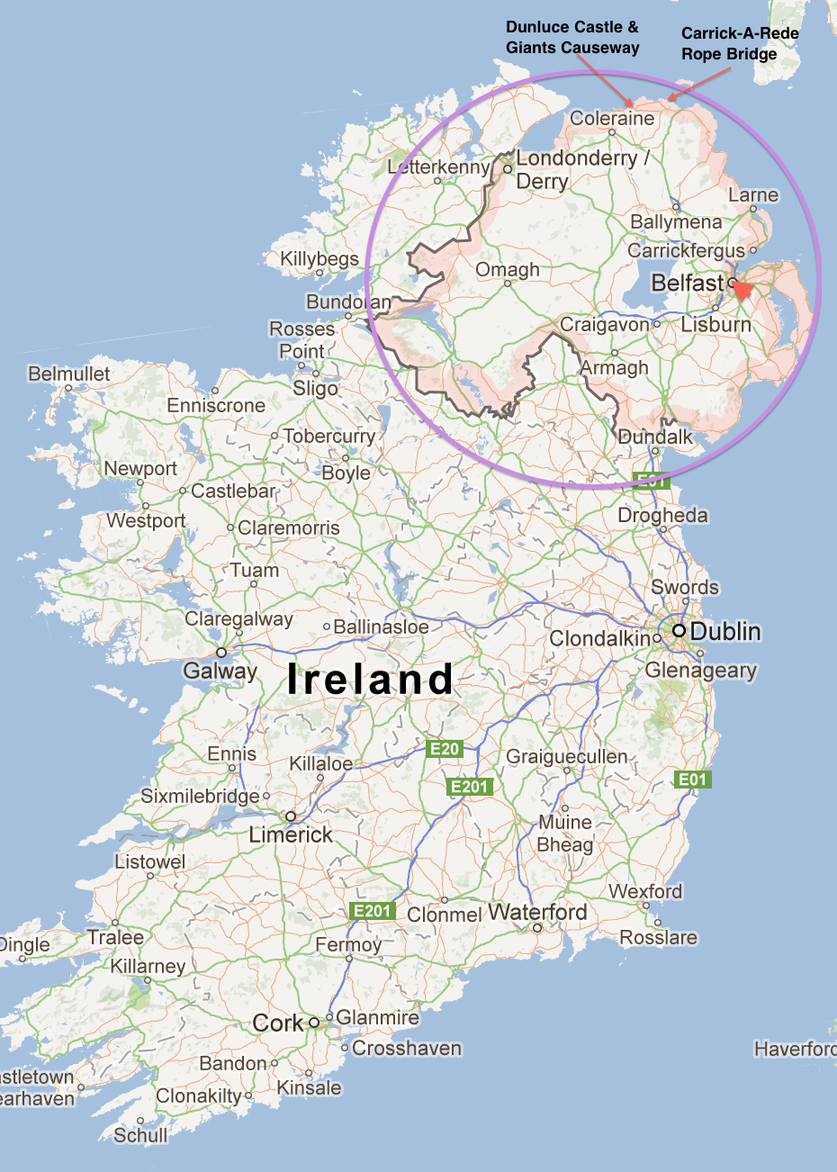
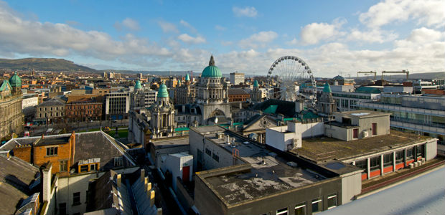
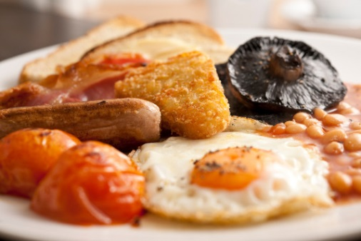
Northern Ireland
Belfast is the biggest city in Northern Ireland and it is the capital.
One of the most famous meals in Northern Ireland is called the Ulster’s fry, which in England is known as a Full English.
Northern Ireland is the smallest country in the United Kingdom. It is smaller than Wales.

Slide 3
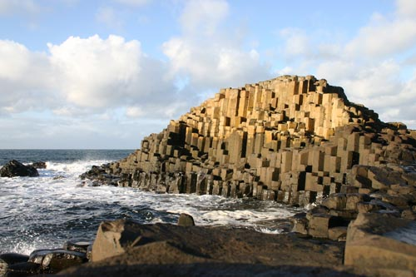
What are the most famous landmarks in Northern Ireland?
Giant’s Causway is one one of the most famous landmarks in Northern Ireland.

Slide 4
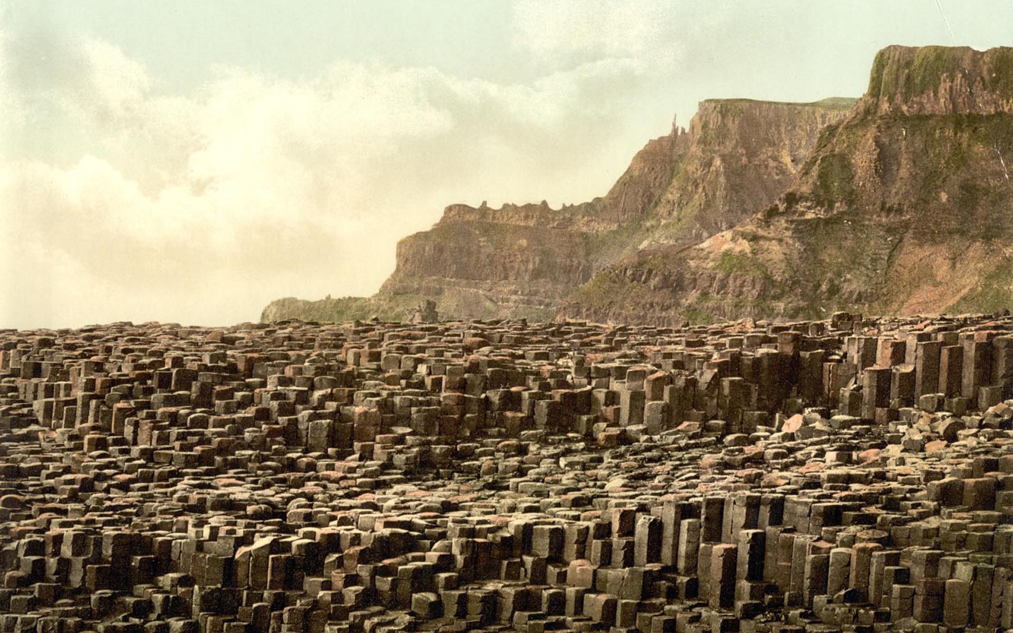
Giant’s causeway is made of about 40,000 columns. It was created by an ancient volcanic eruption.
However, there is a more interesting story. Legend says that the Giant’s causeway was actually built by a giant.

Slide 5
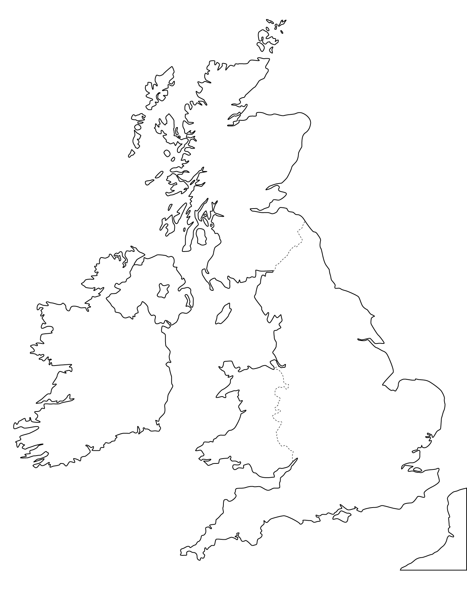
How can you travel to London from Belfast?
From here
To there

