Slide 1
science
DESI Y TXELL

Slide 2
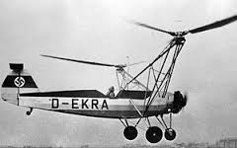
When was invented ?
The first helicopter was invented in 1936.

Slide 3
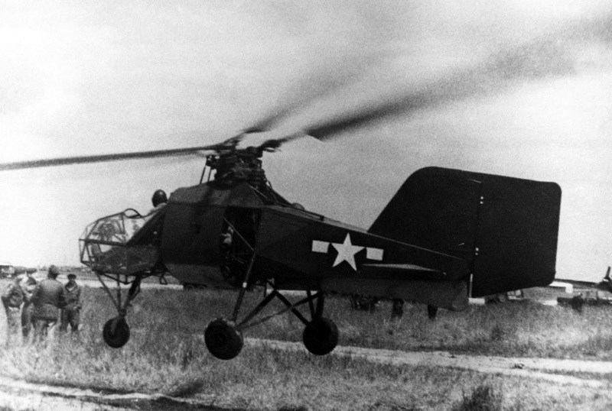
When was invented?
The second helicopter was invented in1941 in germany. The name was: Flettner FL 282 kolibri .

Slide 4
Who invented it:
The first helicopter was created by german doblhoff and the second by Freeman Field.

Slide 5
INTERESTING VIDEOS:
https://youtu.be/urVLrecZRk4
https://youtu.be/CkDKb65daaA

Slide 6
Thanks for listening

