Slide 1
South America
MARINA , IVET AND IVAN

Slide 2
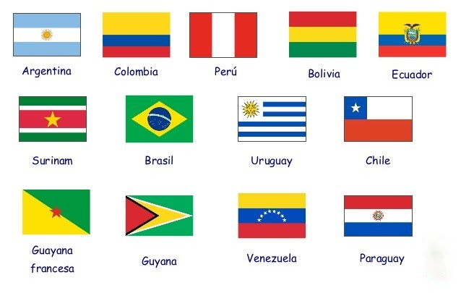
South America countries:

Slide 3
Information
The biggest country is Brasil and the smallest country is Surinam.
The highest mountain is Aconcagua and the longest river is Amazon River.
On the left of South America there is the Pacific Ocean and on the right there is the Atlantic Ocean.

Slide 4
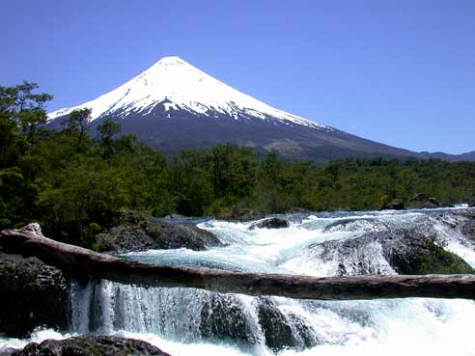
Volcano Osorno
Volcano Osorno is the most famous volcano in Chile as it is one the symbols of the Lake Region landscape.It’s also one of the most active volcanoes in the southern region of Chile.

Slide 5
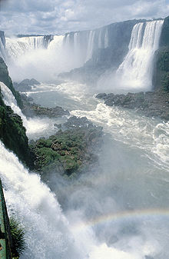
Waterfall
In Argentina, there is the waterfall called Iguazu Falls.
Iguazu Falls is very beautiful to see.

Slide 6
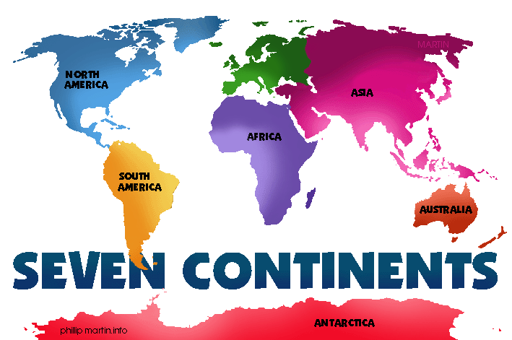
Seven continents
The seven continents include Africa , Antartica , Australia , Asia , Europe , North America and South America.
North America and South America are the second biggest continents after Asia.

