Slide 1
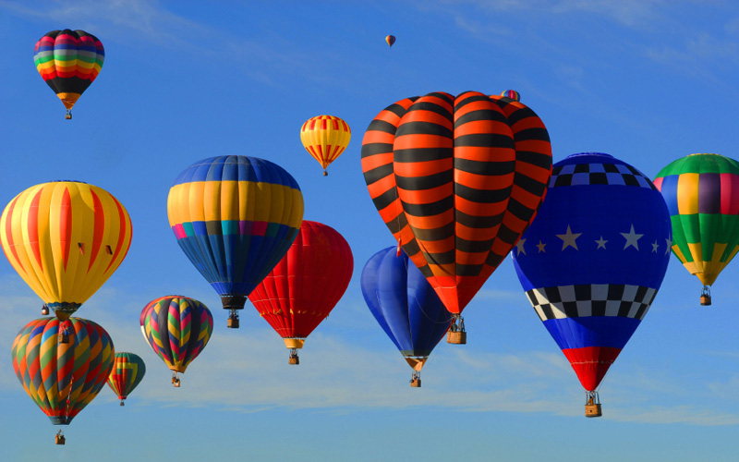
hot air BALLON
Cristina Aguilera
Ivette Hidalgo
Nerea Jimenez

Slide 2
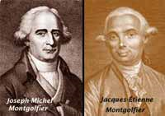
who invented it??
The hot air balloon was invented by Jacques and Joseph Montgolfier .
There are different versions of how it was created. On one hand, it is said that the oldest brother, Jacques, was inspired when he saw his wife putting a thin cloth skirt over a campfire and the skirt inflated. On the other hand. It is said that one day, while the brothers lay before the fire, they realized that the heat given off up a paper bag that was on top.

Slide 3
WHEN WAS INVENTED AND WHO LAUNCHED???
On the 19th September 1783, Pilatre De Rozier, a scientist, launched the first hot air balloon called 'Aerostat Reveillon'. The passengers were a sheep, a duck and a rooster and the balloon stayed in the air for a total of 15 minutes before crashing back to the ground.

Slide 4
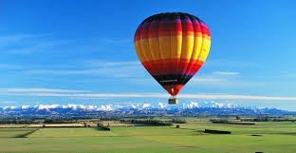
HOW FAST CAN IT TRAVEL???
The balloon carries the wind speed. An acceptable value is from 1 to 20 km / h. It depends on the wind.

Slide 5
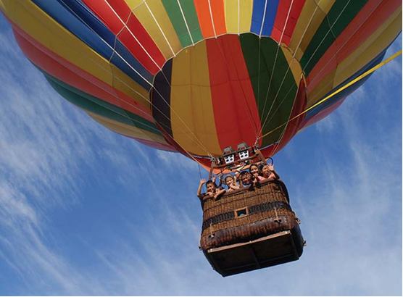
how many passengers can it carry??
There are some small balloons, called hoppers, which are for one person. In some places they have flown balloons for up to 25 people. Within this range there are baskets of all kinds.

Slide 6
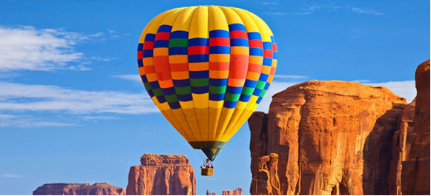
Is it safe?
The balloons are the safest aircrafts in the world.

Slide 7
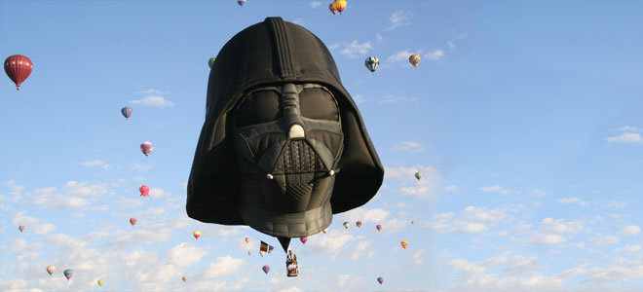
What is its size? Is it big or small?
The balloons can carry from one passenger to 20 passengers.

Slide 8
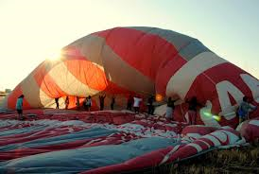
What’s their weight?
The total weight of a balloon-empty-without passengers is 250-300 kg

Slide 9
hope you liked it!!!!!!!!

