Slide 1
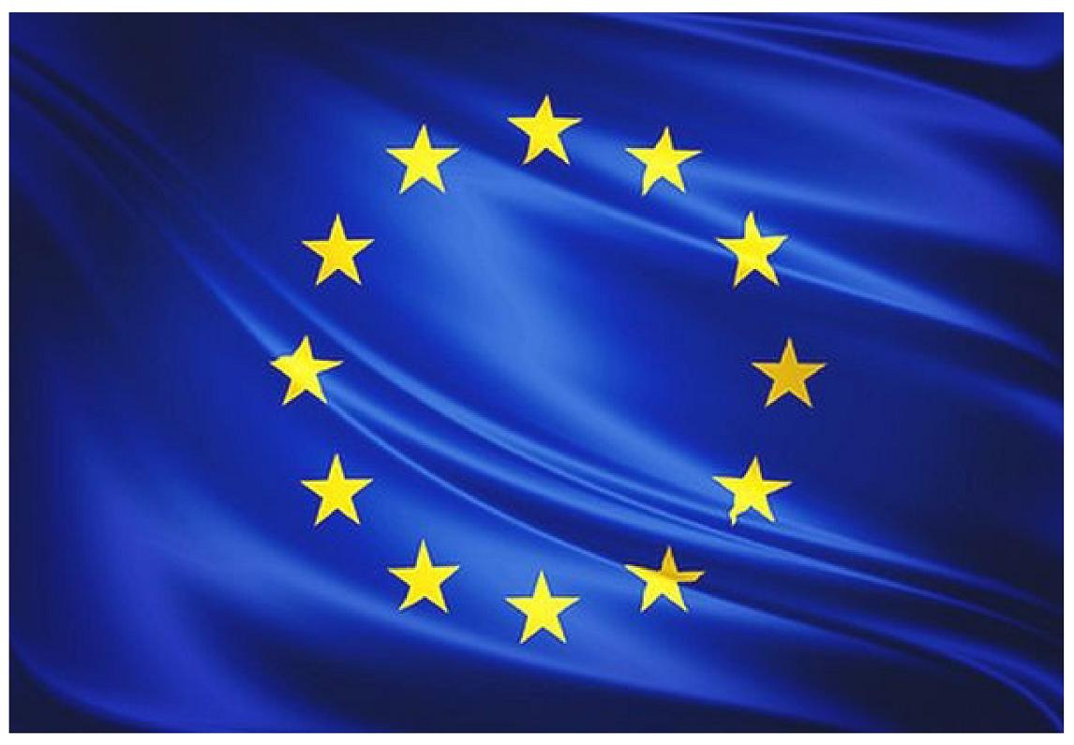
Europe

Slide 2
How many countries does it have ?
Europe has around 50 countries .

Slide 3
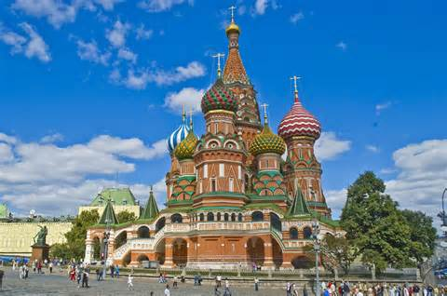
What is the biggest country?
The biggest country of Europe is Russia. It measures 17.045.000km2.There are 2.600.000 inhabitants.

Slide 4
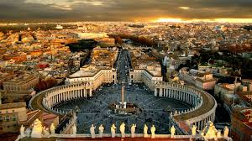
What is the smallest country?
The smallest country of Europe is Vatican city. It measures 0.44km2. There are 940 inhabitants.

Slide 5
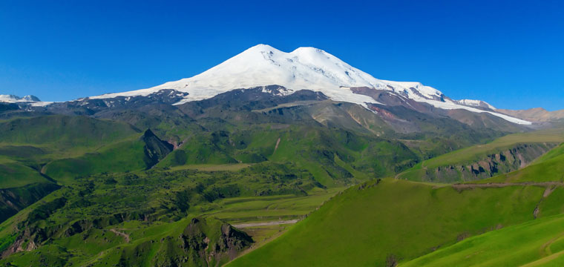
What’s the highest mountain?
Mount Elbrus is the highest mountain in the European continent .
It is located in Russia. It measures 5,642 meters.

Slide 6
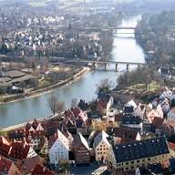
What’s the longest river?
The longest river of Europe is Danube.
It measures 2.888km,it is born in the Black Jungle.

Slide 7
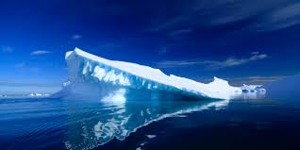
What oceans or seas surround it?
The Artic Ocean in the North, the Atlantic Ocean in the west. In the South , there is the Mediterranean Sea.

Slide 8
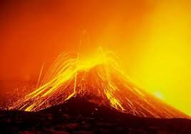
Is there any famous volcano?
In Europe there are 4 volcanos . Mount Etna and Vesuvius in Italy, Santorini in Greece, and Teide in the Canary islands.

Slide 9
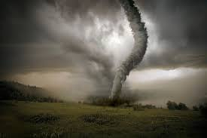
Has it happened any important earthquake ?
This earthquake took place on May 11, at 18:47 in Lorca (Murcia).
9 persons died in the earthquake.

Slide 10
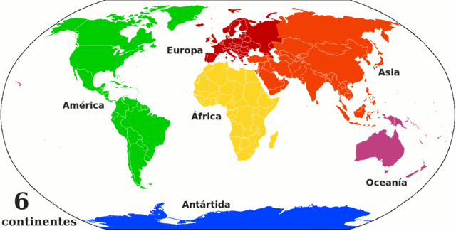
It is bigger or smaller than the other continents?
It’s the second smallest continent in the world.

Slide 11
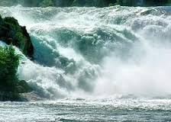
Can we find any waterfall?
In the north of Switzerland we can find the waterfall of the Rhinefall .

Slide 12
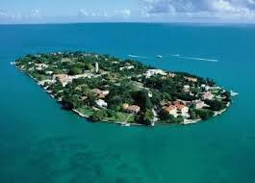
Can we find any island?
Great Britain, Canary islands…

Slide 13

The end
By Carla,Laura,Celtia
and Izan

