Slide 1
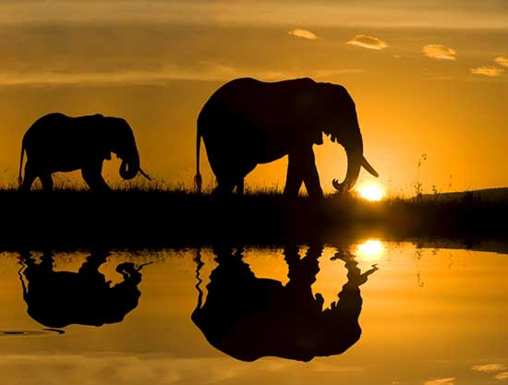
africa
Alba De la Rosa Nayra Martín

Slide 2
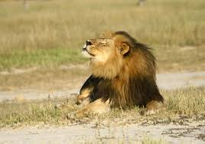
The contruies
In Africa, there are fifty four countries. Africa is the second biggest and most populous continent of the word.

Slide 3

EARTHQUAKES
Earthquakes are usually quite brief, but may repeat. They are the result of a sudden release of energy in the Earth’s crust. This creates seismic waves, which are waves of energy that travel through the Earth.

Slide 4
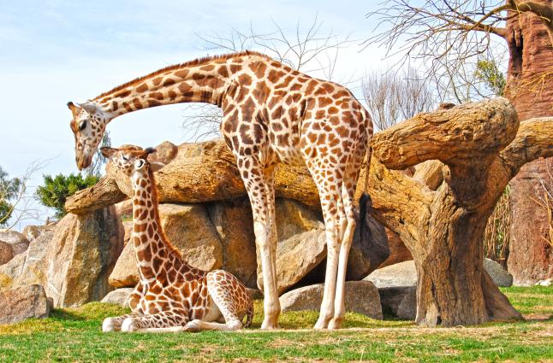
Animals
In Africa, there are lots of animals:
Elephants
Zebras
Rhinos
Lion
Gorillas

Slide 5
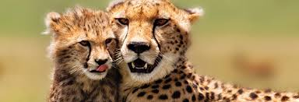
Island
An example of African island is Madagascar . It is very big and it has got many trees.

Slide 6
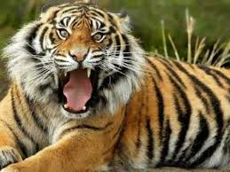
Oceans surround africa
The Atlantic ocean surround Africa in the west and the Indian ocean in the east.
NAYRA,ALBA AND ALINA

Slide 7
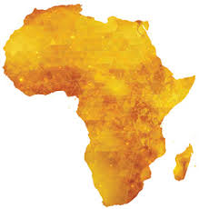
CLIMATE
Weather in Africa can be classified as tropical. Temperatures vary greatly across the continent.

