Slide 1
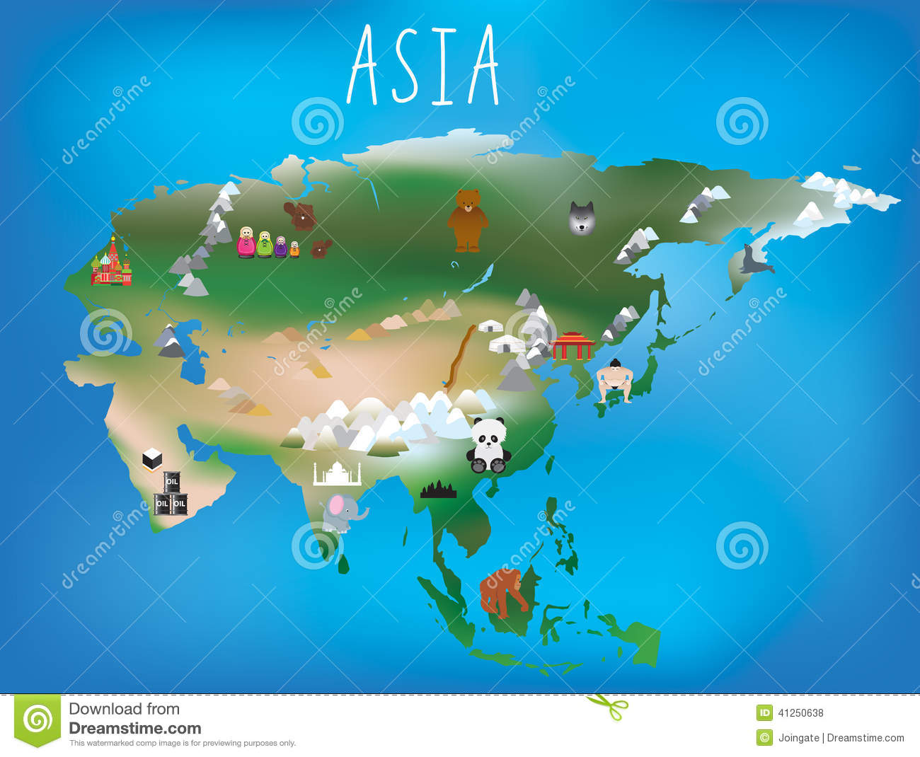
ASIA

Slide 2
ASIA HAS 48 COUNTRIES.
THE AREA OF ASIA IS 44,579,000 km²
POPULATION OF ASIA :4,164,252,000

Slide 3
THE BIGGEST COUNTRY OF ASIA IS RUSSIA AND THE SMALLEST IS MALDIVES.
EVEREST IS THE HIGHEST MOUNTAIN OF ASIA.

Slide 4
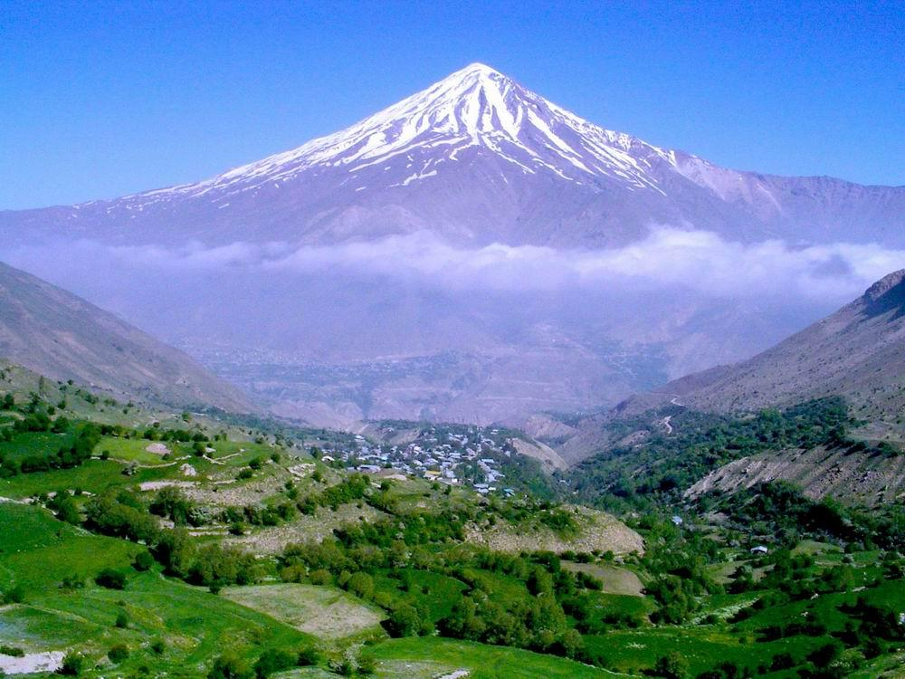
THE LARGEST RIVER IS YANGTZE - 6,300 km.
MOUNTAIN DAMAVAND IS A VOLCANOE.

Slide 5
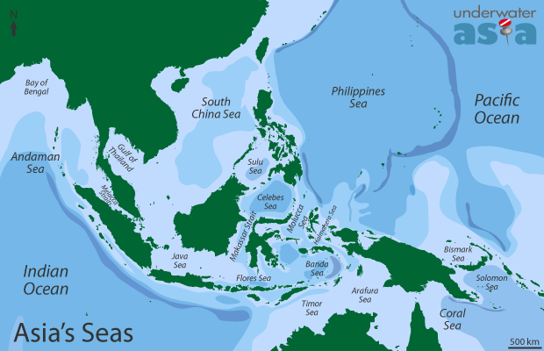
THE SEAS OF ASIA

Slide 6
THE INDONESIAN EARTHQUAKE MADE A LOT OF DAMAGE.
ASIA IS THE BIGGEST CONTINENT.
IN ASIA THERE’S THE GOBI DESERT,JAPAN ISLAND AND Nohkalikai Falls.

Slide 7
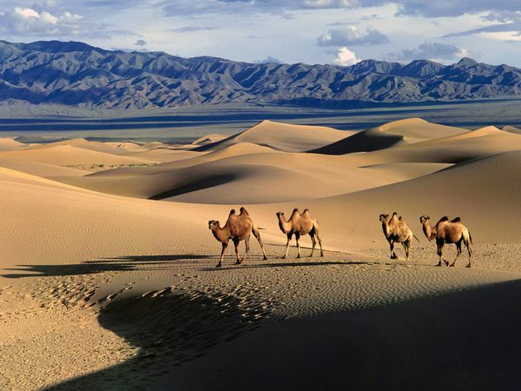
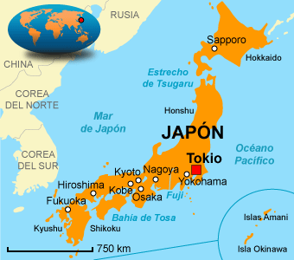
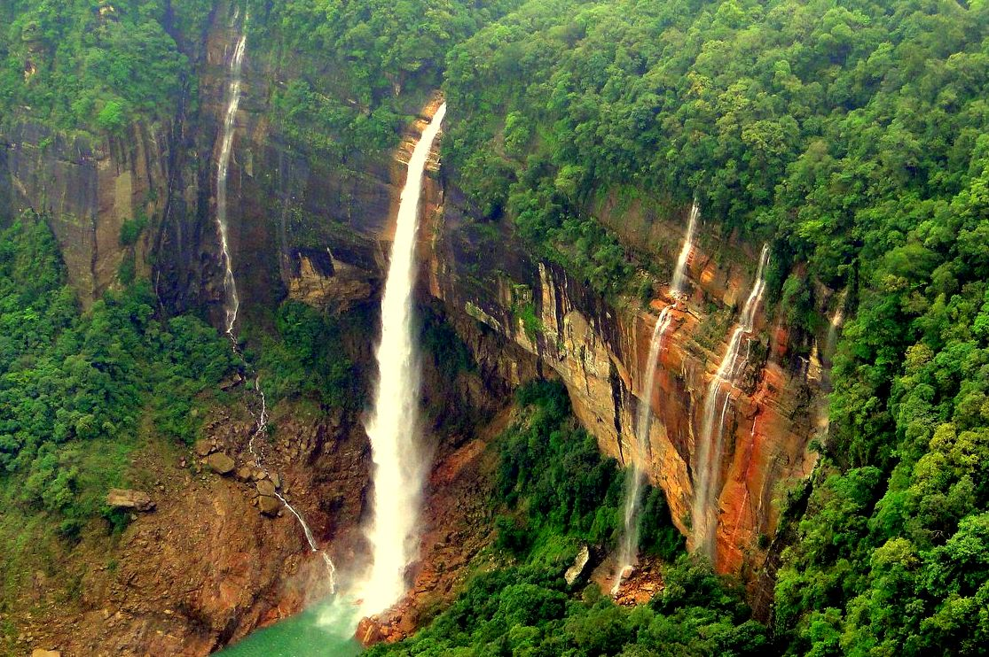

Slide 8
https://www.youtube.com/watch?v=qH3EDsuPFhM

Slide 9
MADE BY ADRIAN.G,RUBÉN AND NÉSTOR.

