Slide 1
BIPLANE
For César Gallardo and
Pol Latorre

Slide 2
HISTORY
In the early days of aviation, the biplane was the most popular way to fly.

Slide 3
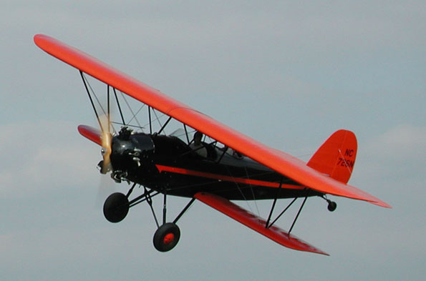
Overview
-In a biplane aircraft, two wings are placed one above the other. Each provides part of the lift.
-Although they are not able to produce twice as much lift as a single wing of similar size and shape .

Slide 4
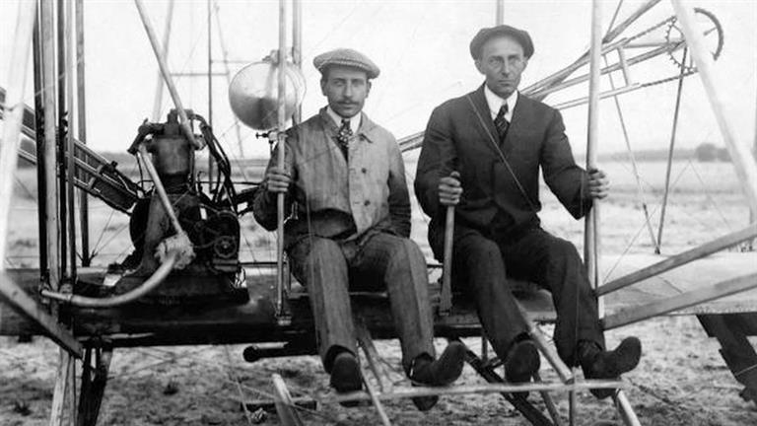
WHEN WAS INVEBTATED? AND WHO?
The Wright brothers invented the biplane in 1903.
It became the first successful powered aeroplane.

Slide 5
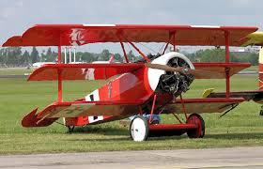
HOW FAST CAN IT TRAVEL?
Some of the best biplanes can travel at 145mph.
The fokker DR.1 triplane was a very agile aircraft and cloud climb very fast.

Slide 6
HOW MANY PASSENGERS CAN IT CARRY?
- The biplane can carry two passengers: the pilot and the passenger.

Slide 7
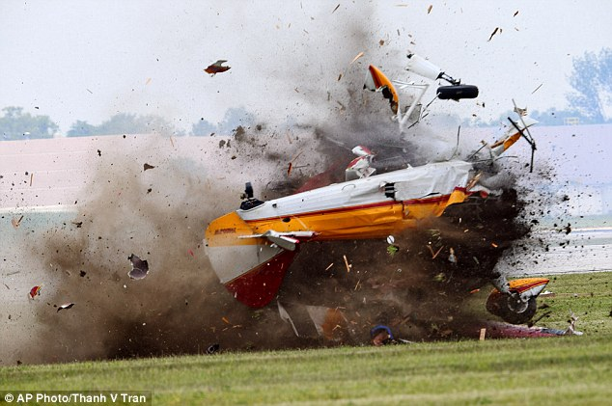
IT IS SAFE?
It is safe but going by plane has risks :

Slide 8
WHAT IS ITS SIZE? IS IT BIG OR SMALL?
The biplane is small to be a plane because planes can normally carry lots of persons and the biplane can only carry two people.

Slide 9
Advantages and disadvantages
The main advantage of the biplane over the more traditional single plane or monoplane is that combine great stiffness with light weight.

Slide 10
BYE BYE

