Slide 1
JET PLANE
Xavi and Mika

Slide 2
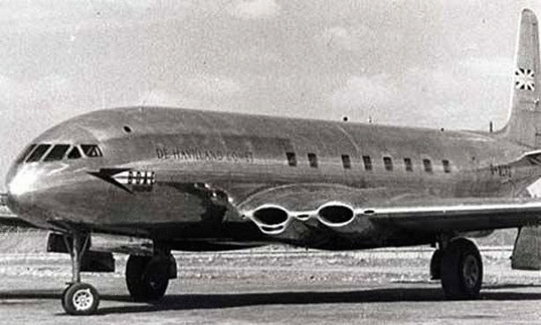
WHEN WAS INVENTED?
The first time that a jet plane took flight was on July 27 of 1949. This jet plane the British “ De Havilland Comet” made its maiden test-flight in England.

Slide 3
How fast can it travel?
The jet plane can travel from a restriction of 290 mph when the plane is under to 10’000 m.

Slide 4

WHO INVENTED IT?
It was invented by sir Geoffrey de Havilland and for this reason, the plane was called the De Havilland Comet.
Sir Geoffrey was an aircraft designer and aviation pionner.

Slide 5
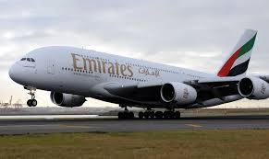
HOW MANY PASSENGERS CAN IT CARRY?
The A380,the biggest jet plane can carry around 525 passengers for each travel , but the normal jet plane can carry around 100 or 200 passengers in each travel

Slide 6
DOES IT HAVE WINGS?
All the jet planes have got wings because without wings the plane
can’t fly.

Slide 7
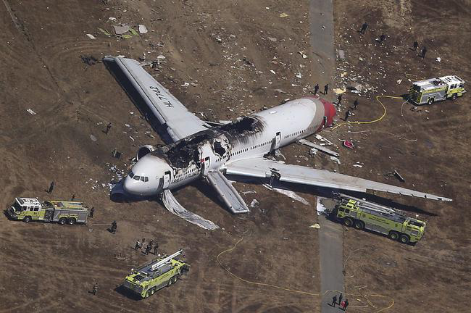
IS IT SAFE?
Nobody proved that a jet plane is safe but normally the planes are safe and comfortable.

Slide 8
WHAT IS ITS SIZE? IS IT BIG OR SMALL?
A jet plane is always big but some of them are smaller.

Slide 9
HAVE YOU EVER BEEN IN ONE OF THEM?
Yes , we have been in one of them.
It’s a good experience travel in a jet plane.

Slide 10
3

Slide 11
2

Slide 12
1

Slide 13
BYE BYE!!!

