Slide 1
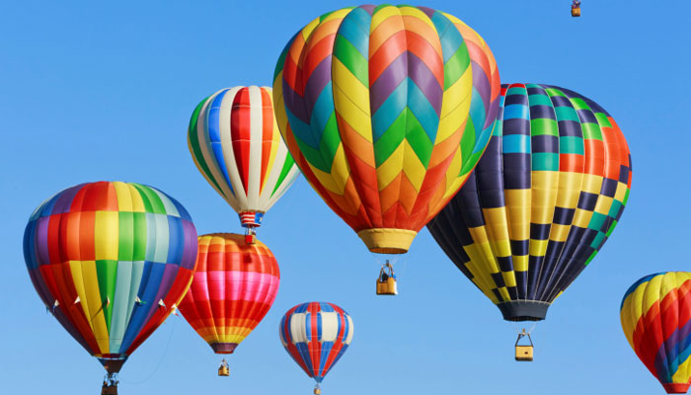
HOT AIR BALLOONS
MARIA & PAULA
SCIENCE 2016

Slide 2
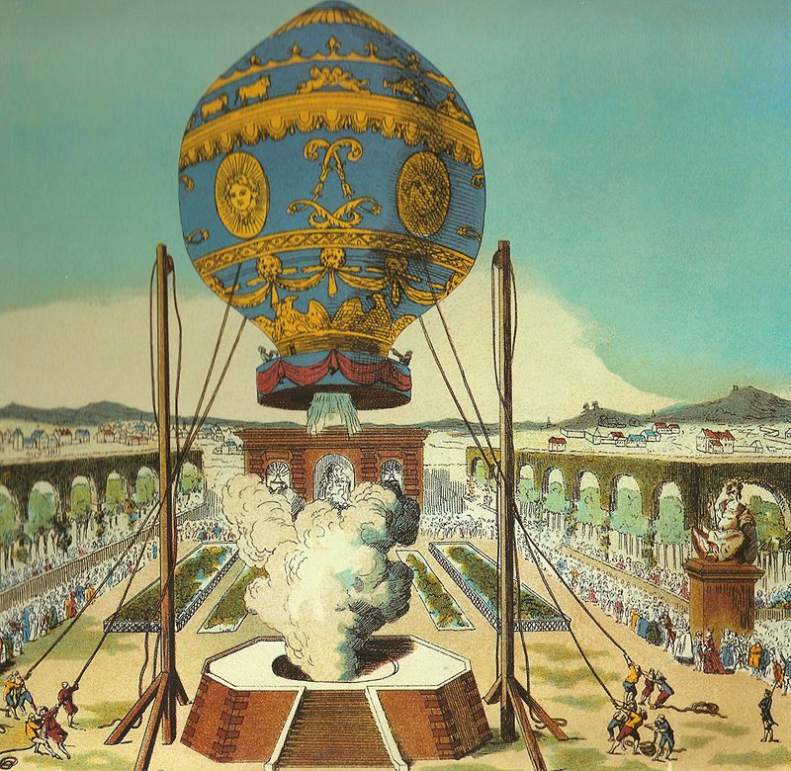
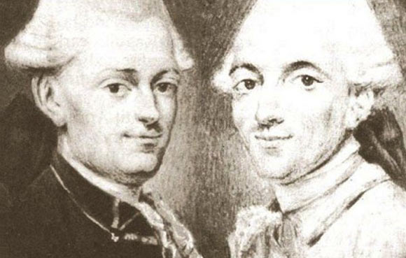
WHEN WAS INVENTED?
The first hot air balloon were invented in China for military signals. Modern hot air balloons were invented in 1783 by Montgolfier Brothers.

Slide 3
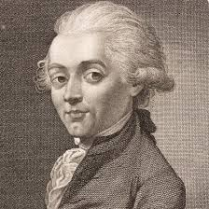
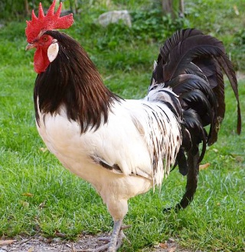
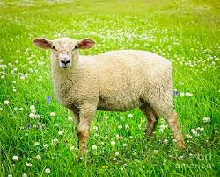
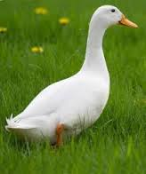
WHAT WERE THE FIRST PASSENGERS?
The first passengers that flew in a hot air balloon were: a sheep , a duck and a rooster. But the first person that flew in a balloon was –Jean –François Pilatre de Rozier.

Slide 4
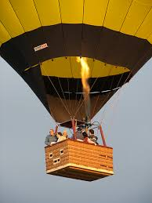
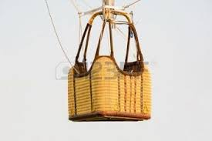
WHAT is THE MAXIMUM PEOPLE THAT CAN FLY?
It depends on the balloon .Well, if the basket is big it can carry sixteen
passengers, but if it is small it can carry ten or twelve.

Slide 5
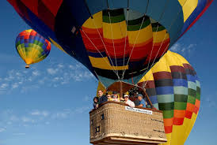
HOW MANY PASSENGERS CAN IT CARRY?
*To safely launch and fly a balloon requires a minimum crew of four people.

Slide 6
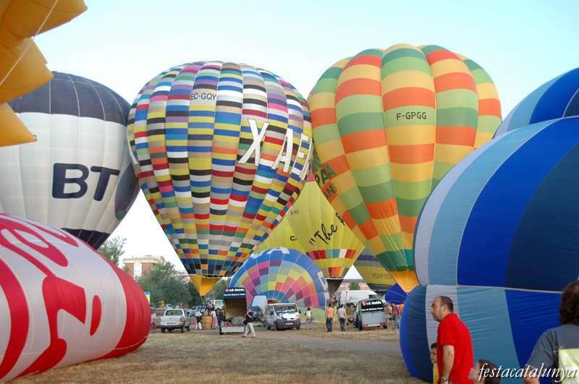
HAVE YOU EVER SEEN ONE OF THEM?
Yes, we see different types of balloons in Igualada in front of the new hospital.

Slide 7
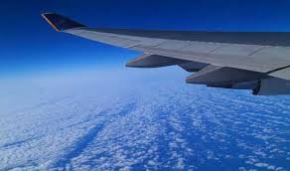
DOES IT HAVE WINGS?
No they doesn’t. They have got a burner but they haven’t got wings to fly. Burner function serves to inflate the balloon fire.

Slide 8
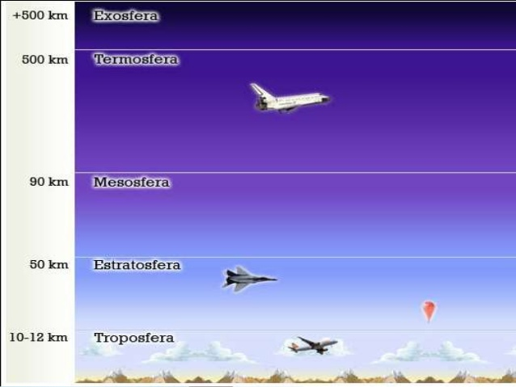
HOW HIGH CAN IT TRAVEL?
The hot air balloon can it travel more or less 10-12 km high.At the middle of troposphere and between stratosphere.

Slide 9
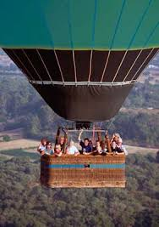
WHAT IS IT THE SIZE? IS BIG OR SMALL?
The most-used size is about 2,800 m3.
They are big only the balloons that only have the big basket.
Only those that are small and have a small burner.

Slide 10
What are the parts of a Hot Air Balloon?
THE BASKET
The Basket or Gondola, as it is sometimes referred to, is where the pilot and passengers are held.
THE BURNER
The burner is what propels the hot air up into the envelope, it is like the engine of the balloon.
THE ENVELOPE
The actual balloon part of a hot air balloon is referred to as 'The Envelope'.

Slide 11
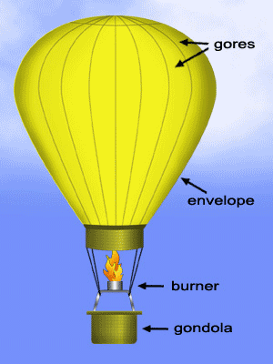
This is an image of what we have seen before:

Slide 12

WE HOPE YOU LIKED IT!☺☺

