Slide 1
The eagles
By Alina and Laura

Slide 2
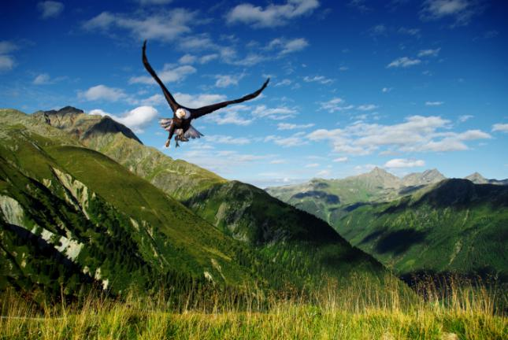
the eagles
There are some 60 species of eagles and they represent a symbol of a freedom and power.

Slide 3
types of eagles
Eagle real,Bonelli’s,Harpy,crowned,osprey,etc…are some examples.
In the US and Canada there are 2 species.
In Australia there are 3 species.
And in South and Central America there are 9.

Slide 4
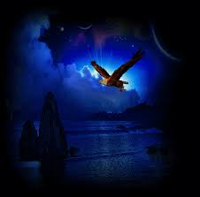
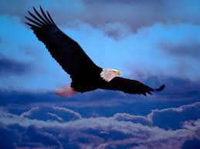
Characteristics
Eagles are diurnal raptors,some are very large and have a majestic appearance.
Eagles are the largest predadory birds.They have powerful claws
The large beak is long and strong.

Slide 5
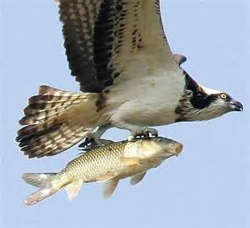
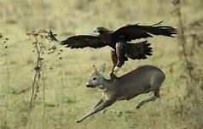
What do they eat?
The Eagle is a carnivore. They usually feed on rabbits, squirrels, snakes, marmots,etc… Some species feed on eggs of birds and fish.

Slide 6
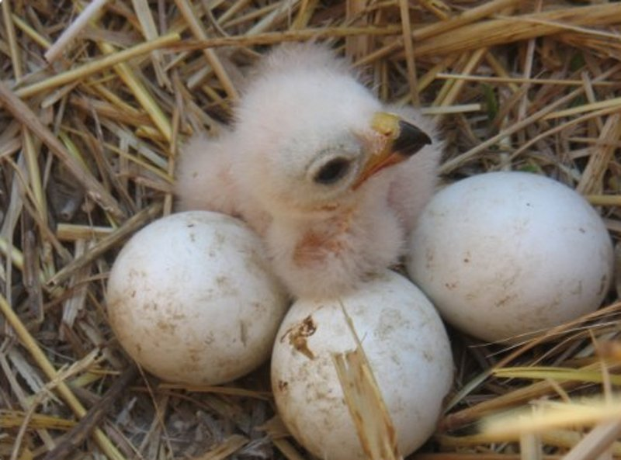
Reproduction
Eagles are birds and as such have oviparous reproduction,that is,to reproduce lay eggs.Eagles tend to nest in high places.As in the of the mountains or tall trees.

Slide 7
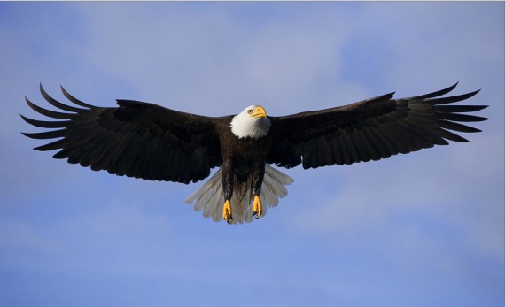
Where do they live?
Deserts,forests,mountains,meadows and marshes.Perch on the branches and trees and clifss to see the landscape and detect prey.

Slide 8
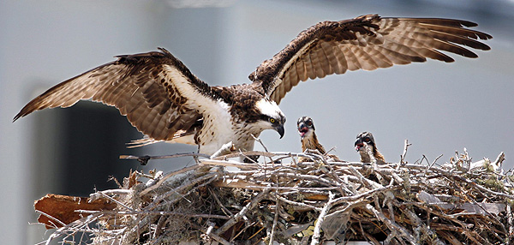
As is his nest?
Usually more tan one meter width.Both adult eagles build nests and it is made of tree twigs and ofter in the nest incubate 1 or 2 eggs.

Slide 9
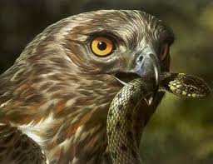
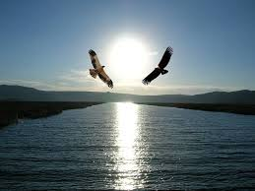

Slide 10
The end
By Alina and Laura

