Slide 1
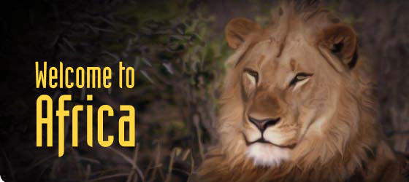

Slide 2
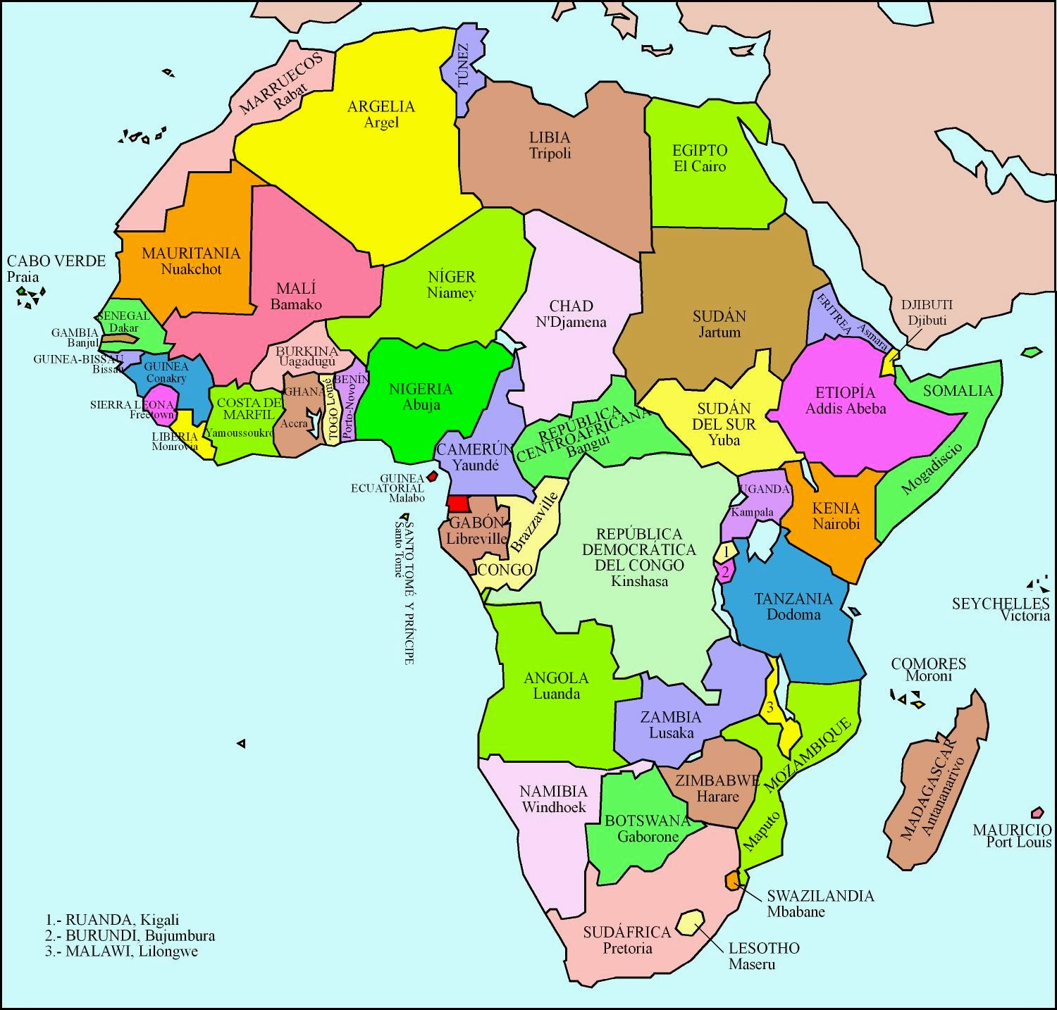
AFRICAN COUNTRIES
There are fifty-four countries in Africa.

Slide 3
THE BIGGEST COUNTRY AND SMALLEST
The biggest country is Argelia. It is located in the northern Africa
The smallest African country is Seychelles
https://youtu.be/VoYp2_MxkMI

Slide 4
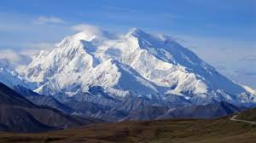
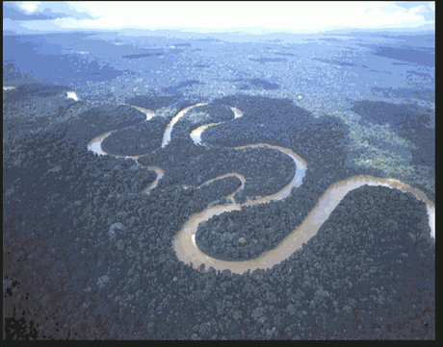
THE HIGHEST MOUNTAIN AND LONGEST RIVER
The highest mountain is Kilimanjaro.
The longest river is Nil. It is located in Egypt.

Slide 5
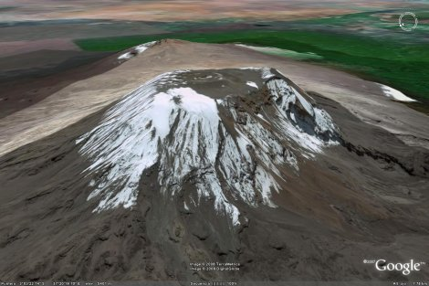
THE OCEANS AND SEAS THAT SURROUND IT AND FAMOUS VOLCANO
The oceans and seas that surround Africa are Indian and Atlantic Ocean.
The most famous volcano is Kilimanjaro.

Slide 6
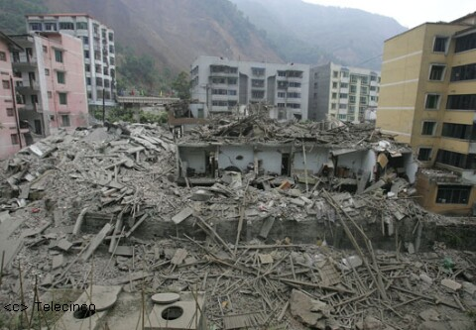
THE MOST IMPORTANT EARTHQUAKE
This earthquake took place in Nairobi.
Africa is a big and a small country. It is bigger than Europe but smaller than South America and North America.

Slide 7
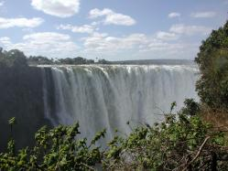
DESERTS, WATERFALL & ISLANDS
The most important desert of Africa is Desert of Sahara.
The biggest waterfall of Africa is the Victorias Waterfall
In Africa there are approximately three hundred islands.

Slide 8
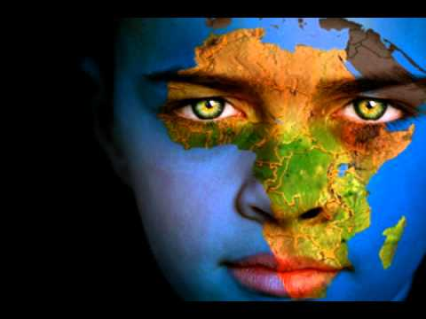
Created by: Eric, Adrian.M & Marc.A

