Slide 1
Maths in English: statistics and its applications
Artificial vision
Rosa Mª Avila
Laia Bayarri
Cristina Lopera
4r B
Ivón Cardenas

Slide 2
Índex
1- Artificial vision
1.1 Introduction to artificial vision
1.2 Augmented reality
1.3 Stereo vision and multi-cam projections
2-Virtual worlds
2.1 Second life
2.2 Open wonderland
2.3 Explain what is Open Scene graphs

Slide 3
1. The artificial vision 1.1 Introduction to artificial vision
Is the computer vision is methods for acquiring, processing, analyzing, and understanding images and, in general, high-dimensional data from the real world in order to produce numerical or symbolic information.
A theme in the development of this field has been to duplicate the abilities of human vision by electronically perceiving and understanding an image.

Slide 4
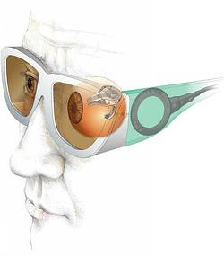
Example

Slide 5
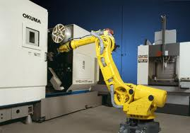
Some applications
Controlling processes, e.g., an industrial robot.

Slide 6
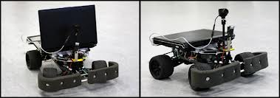
Navigation, e.g., by an autonomous vehicle or mobile robot.

Slide 7

1.2 Augmented reality
OpenCV:

Slide 8
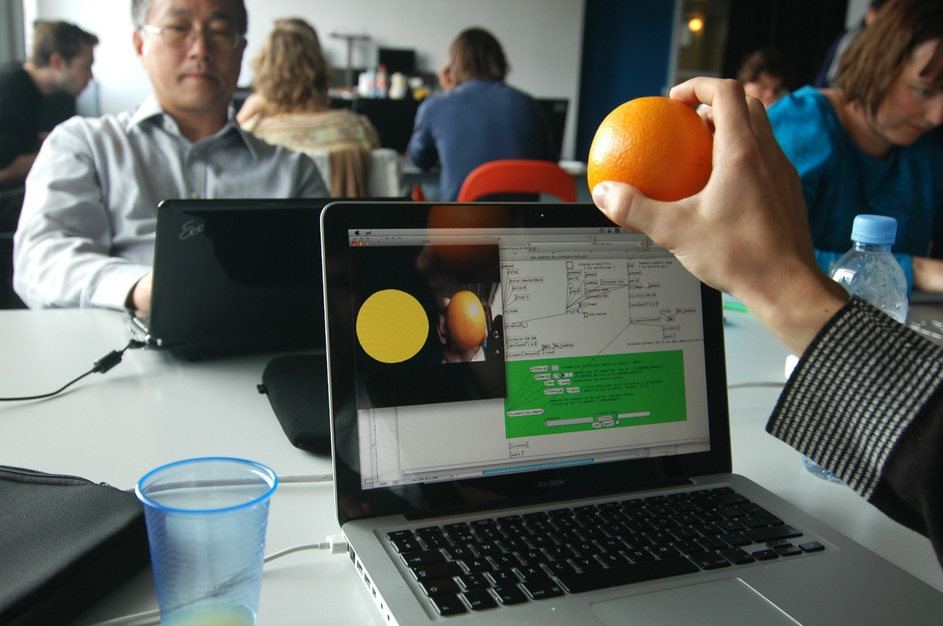
APPLICATIONS
2D and 3D feature toolkit Egomotion estimation .

Slide 9
1.3 Stereo Vision and multi-cam projections
3D reconstruction
In computer vision and computer graphics, 3D reconstruction is the process of capturing the shape and appearance of real objects. This process can be accomplished either by active or passive methods.
Pro Forma
Pro FORMA (Probabilistic Feature-based On-line Rapid Model Acquisition) The invention allows the dimensions of the object read only designated using any ordinary webcam, allowing you to rotate and move any object in front of the camera and be scanned in real time. Advanced mathematical calculations performed to generate three-dimensional views and so ignore any other object than the scanned object.

Slide 10
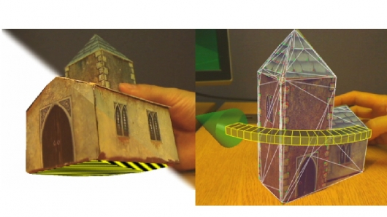
Example

Slide 11
2. Virtual worlds 2.1 Second life
Second Life is an online virtual world developed by Linden Lab. It was launched on June 23, 2003.
Residents can explore the world meet other residents, socialize, participate in individual and group activities, and create and trade virtual property and services with one another. Second Life is intended for people aged 16 and over.
The software is a three-dimensional modeling tool based on simple geometric shapes that allows residents to build virtual objects. There is also a procedural scripting language.

Slide 12
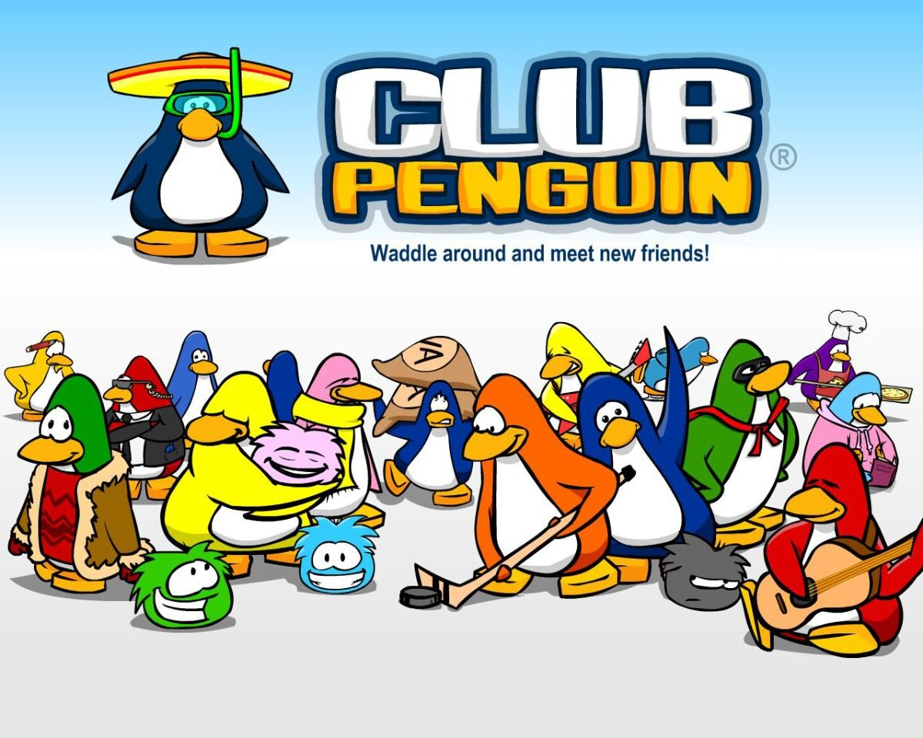
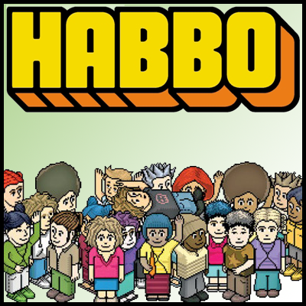
Some features and examples
- Club Penguin - Habbo

Slide 13

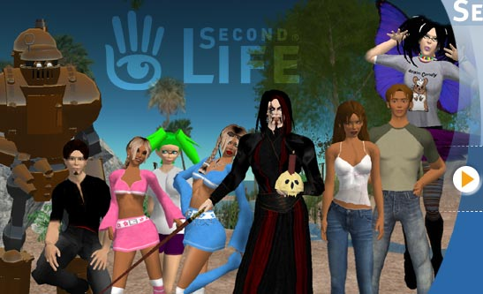
- Smeet
- Second Life

Slide 14

2.2 Open wonderland

Slide 15
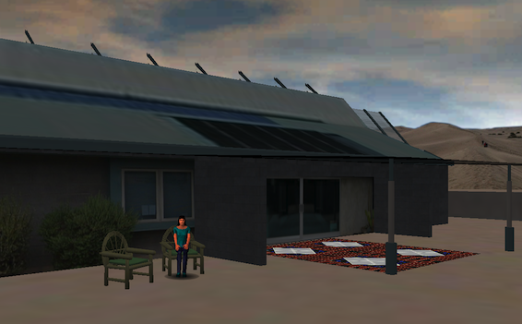
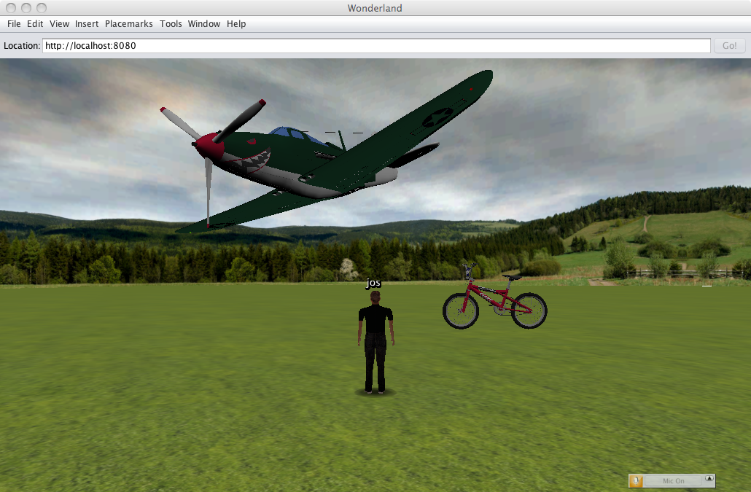
Examples

Slide 16
2.3 Explain what is Open Scene graphs
The Open Scene Graph is an open source high performance 3D graphics toolkit, used by application developers in fields such as visual simulation, games, virtual reality, scientific visualization and modeling. Written entirely in Standard C++ and OpenGL it runs on all Windows platforms, OSX, GNU/Linux, IRIX, Solaris, HP-Ux, AIX and Free BSD operating systems. The Open Scene Graph is now well established as the world leading scene graph technology, used widely in the vis-sim, space, scientific, oil-gas, games and virtual reality industries.

Slide 17
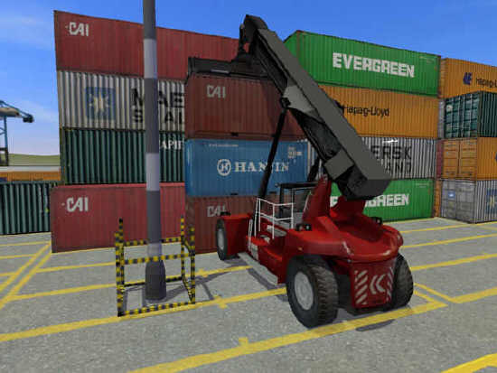
Example

