Slide 1
Emotions
Images from the SEAL pack: http://www.bandapilot.org.uk/pages/seal/ws_photocards.html

Slide 2
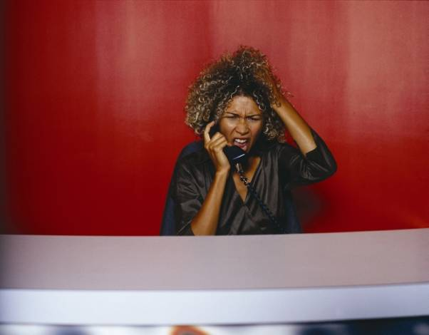
I don’t think it’s a good idea to talk now. She looks like she is feeling …………………
Angry

Slide 3
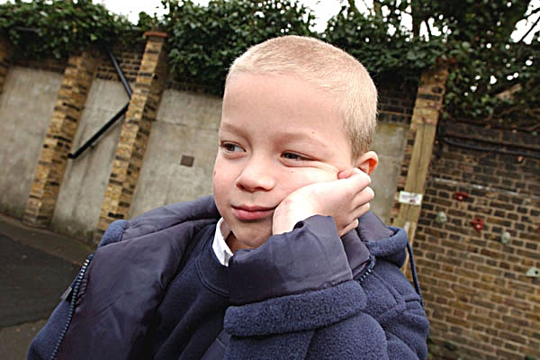
What a face. I think he needs to find something to do. He looks ………………….
Bored

Slide 4
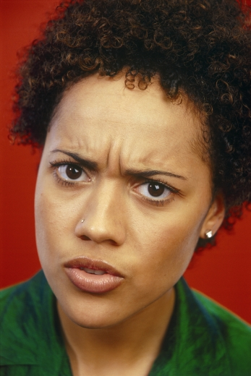
Maybe I should explain things more clearly because she looks …………………………
Confused

Slide 5
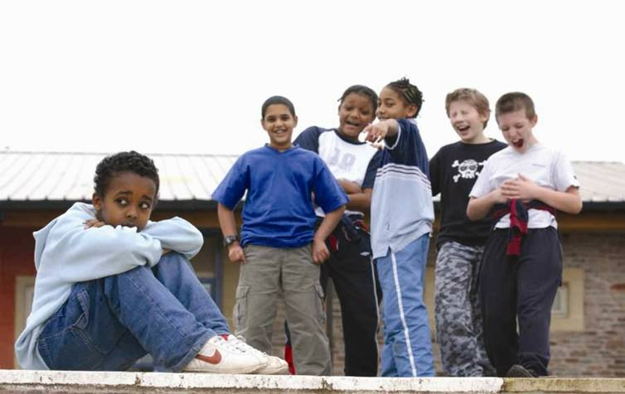
That group of boys are being horrible and they are making the boy sat down feel …………
Embarrassed

Slide 6
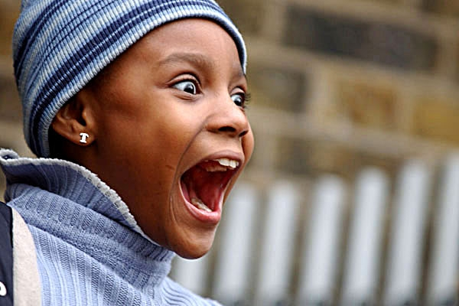
I think all her Christmas’s have come at once. She looks …………………..
Excited

Slide 7
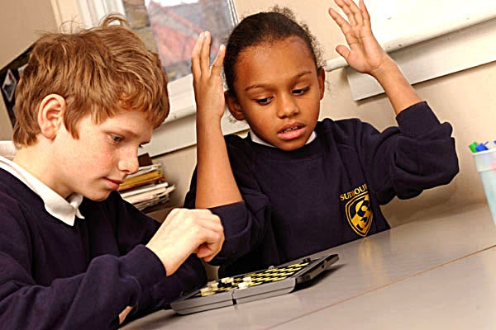
Something isn’t going right for someone. She is getting …
Frustrated

Slide 8
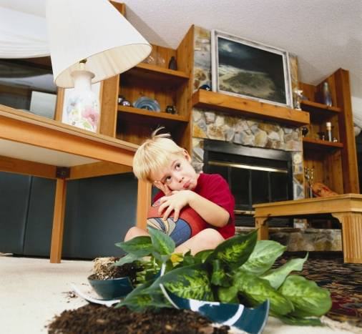
I wonder what his mum will say? I wonder if he’s feeling ………………………?
Guilty

Slide 9
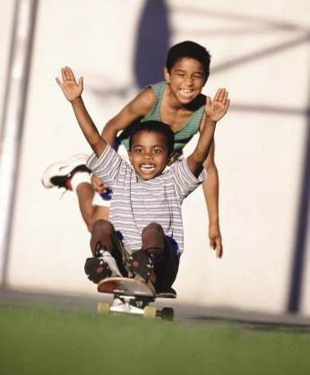
Wow this looks fun. Both the boys look …………
Happy

Slide 10
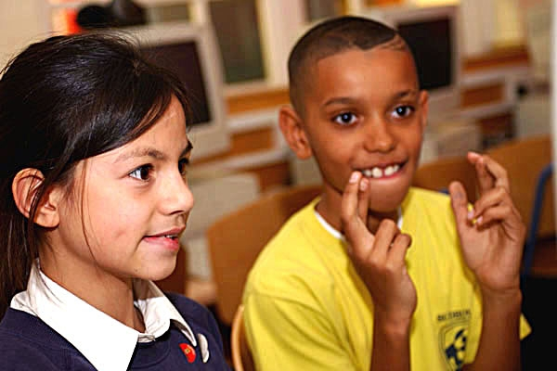
I think he wants to be picked. He is looking ……………………..
Hopeful

Slide 11
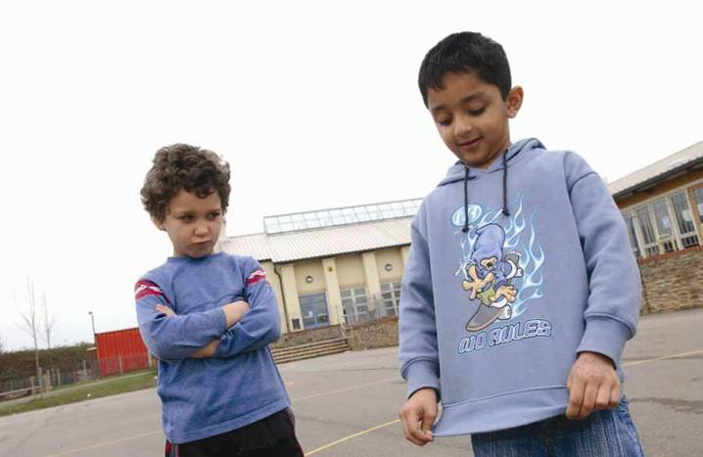
I think that the boy on the left wishes he had that top. He looks like he is feeling ………..
Jealous

Slide 12
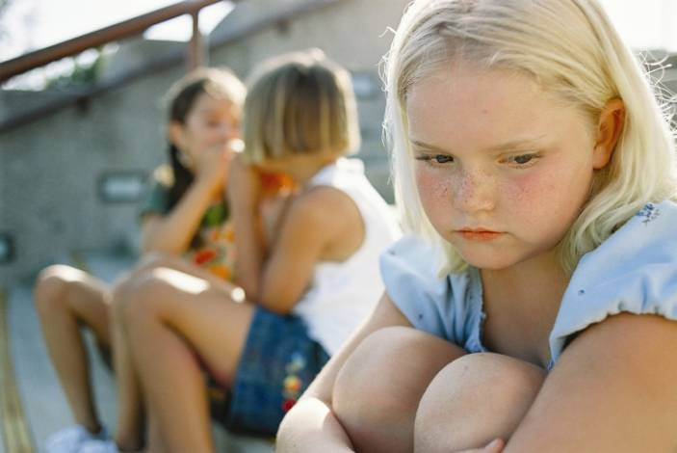
The other girls won’t let her join in. She is feeling ………………………….
Left out

Slide 13
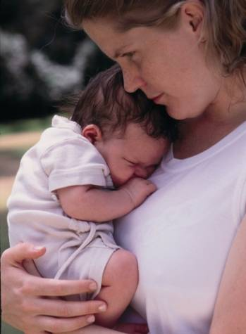
Look at this bundle of loveliness. This baby is feeling …………..
Loved

Slide 14
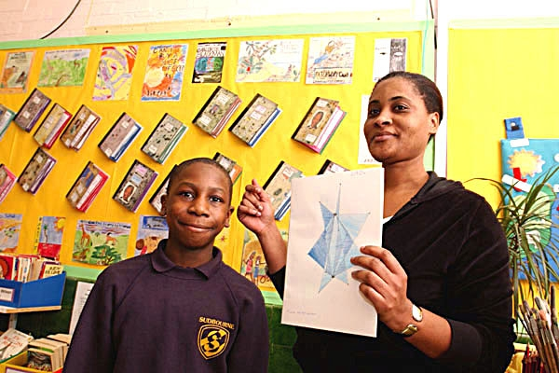
The teacher is showing everyone his work. I bet he feels ……………..
Proud

Slide 15
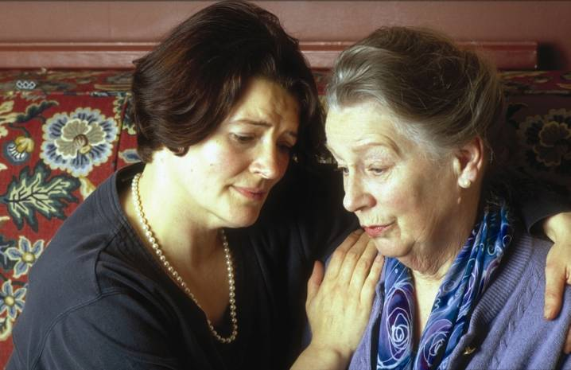
Oh dear I wonder what has happened. They both look …………..
Sad

Slide 16
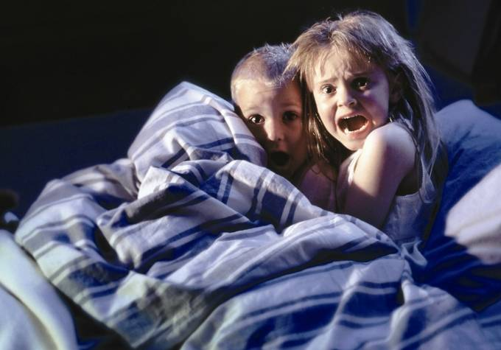
I think they’ve been watching horror films. They both look …………….
Scared

Slide 17
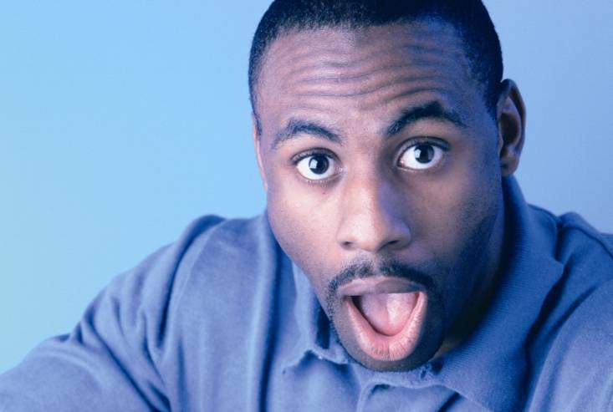
Did something just happen that he wasn’t expecting. He looks ………….
Surprised

Slide 18
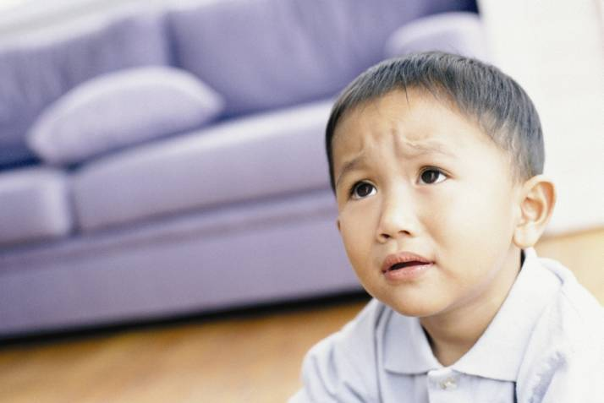
I think he has the weight on his shoulders. He looks ……………………
Worried

Slide 19
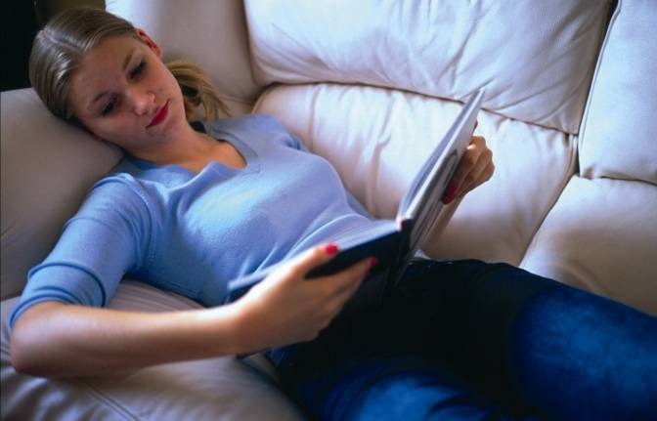
Not a care in the world, curled up with a good book. She looks …………………….
Relaxed

Slide 20
Together, look through the slide show and tell me about one occasion that you have felt one of these emotions

