Slide 1
Where I’m from

Slide 2
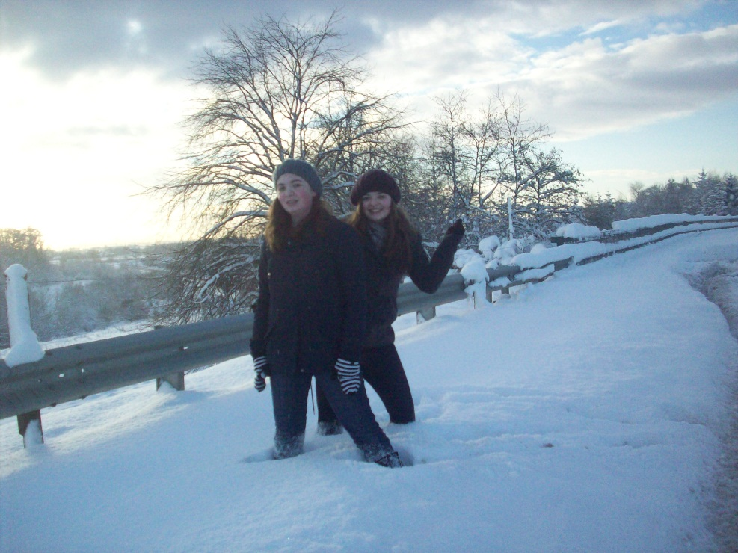
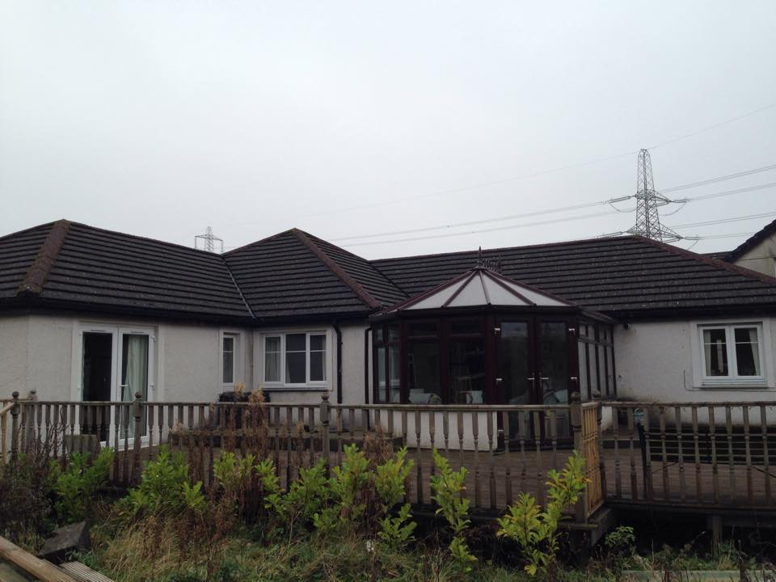
My house
I live on a farm.
There are horses that live in our fields.
We have a bungalow with four bedrooms.
My favourite room is the study because there are a lot of books there.
My bedroom walls are blue because that it my favourite colour.

Slide 3
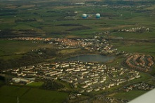
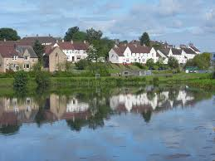
My village
I come from a village called Glenboig, about 12 km from Glasgow.
Glenboig has got four shops and two primary schools.
It also has a hairdressers and a two churches.
It doesn’t have a cinema or a library.

Slide 4
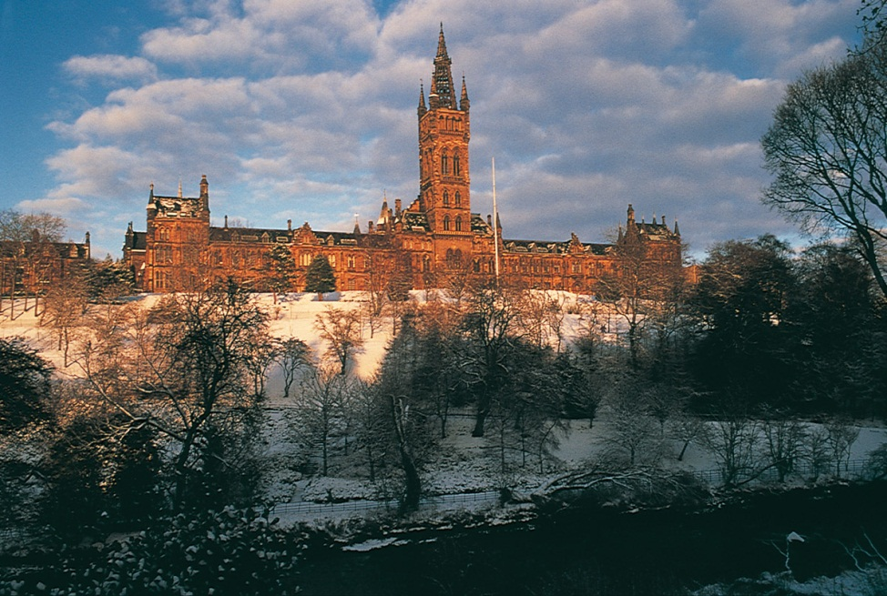
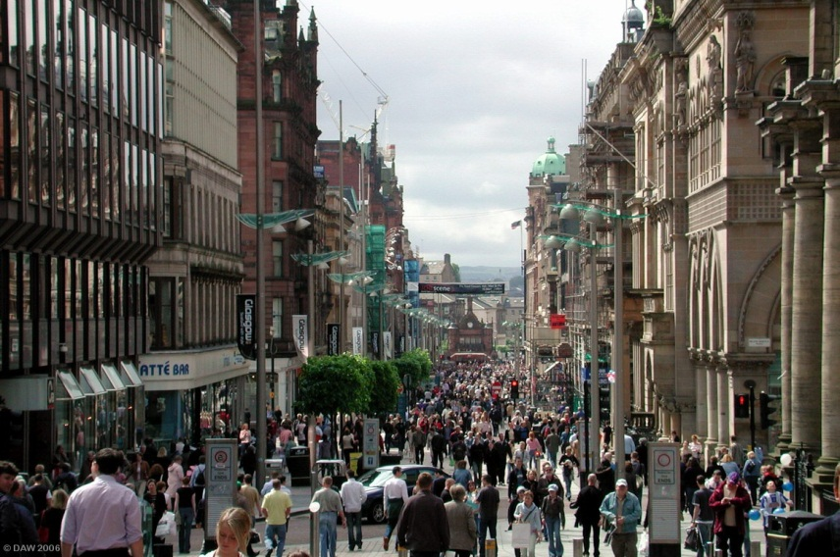
Glasgow
Glasgow is the biggest city in Scotland.
It is bigger than the capital city – Edinburgh.
There are lots of shops and things to do in Glasgow.
The people are very friendly there.
I used to go to Glasgow by train everyday to go to university.

Slide 5

Questions & Answers
What type of house do I live in?
  A bungalow on a farm.
What kind of animals live on the farm?
  There are horses.
How many shops does Glenboig have?
  It has got four shops.
Does it have a cinema?
  Not it does not have a cinema.
Which city is bigger – Glasgow or Edinburgh?
  Glasgow is bigger. It is the biggest city in Scotland.
Why did I have to go to Glasgow every day?
  I had to go to university.

Slide 6

Individual Activity
Prepare a short description of your town or city using the frames provided.
If you need any vocabulary please ask either Mary Ann or Gemma for help.

