Slide 1
About Me

Slide 2
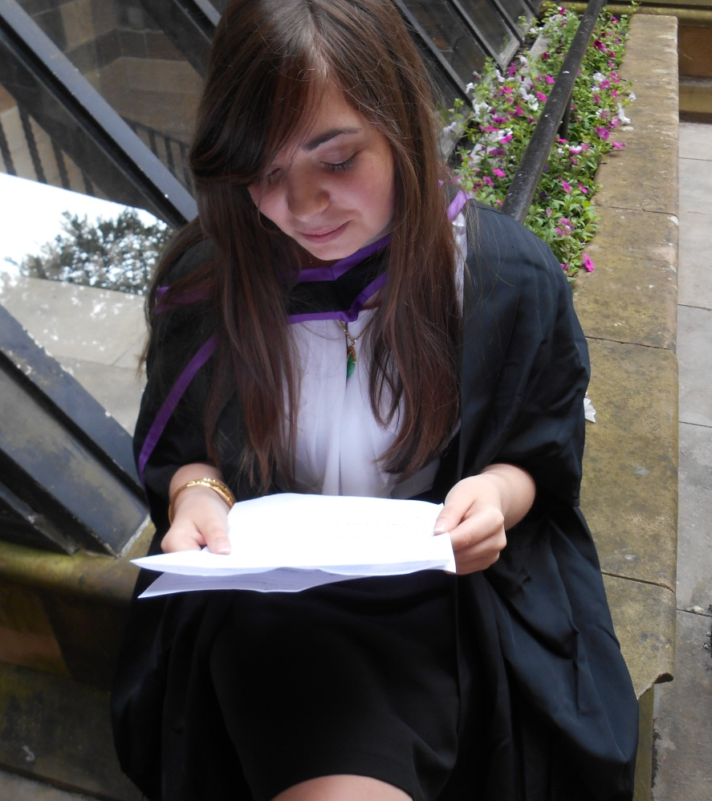
Who am I?
My name is Mary Ann.
I am 23 years old.
I come from a small town near Glasgow in Scotland.
I live in Barcelona.
I have one sister.
I like to read, go for walks, watch movies and listen to music.

Slide 3
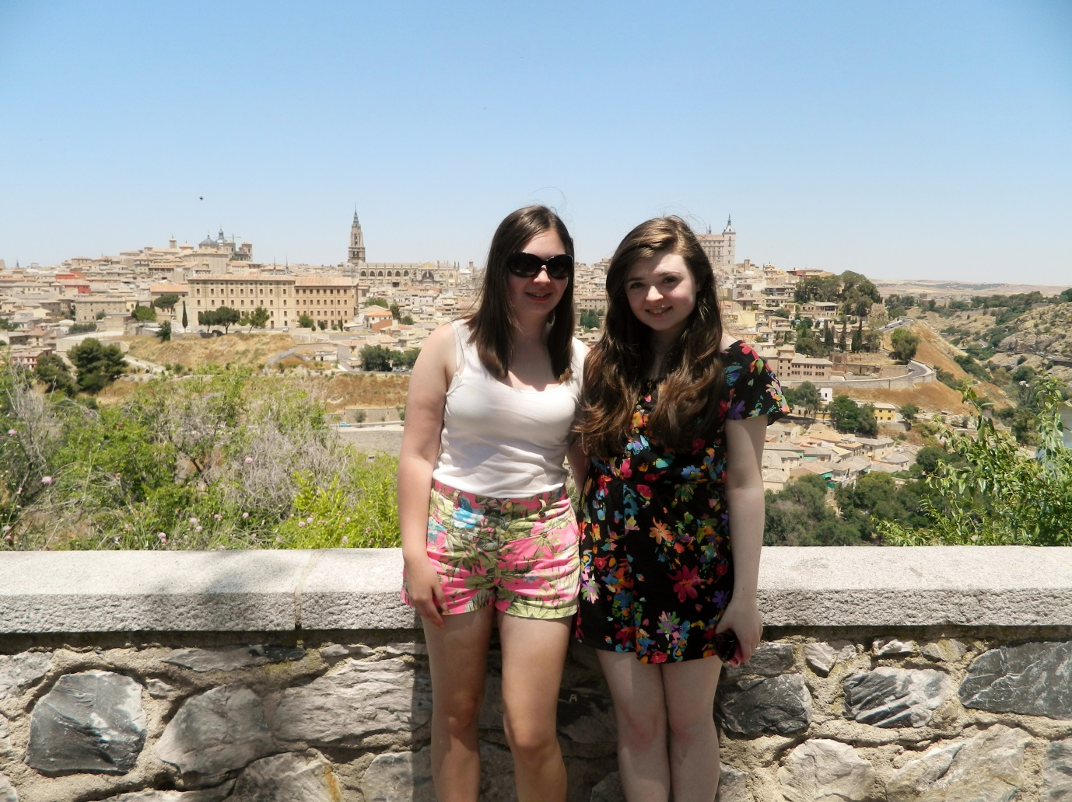
My little sister
My sister is called Katherine.
She is 21 years old.
She studies Law at university.
She wants to be a lawyer or a primary school teacher.
She likes to dance and she sings in a choir.
She has long, brown hair and green eyes.

Slide 4
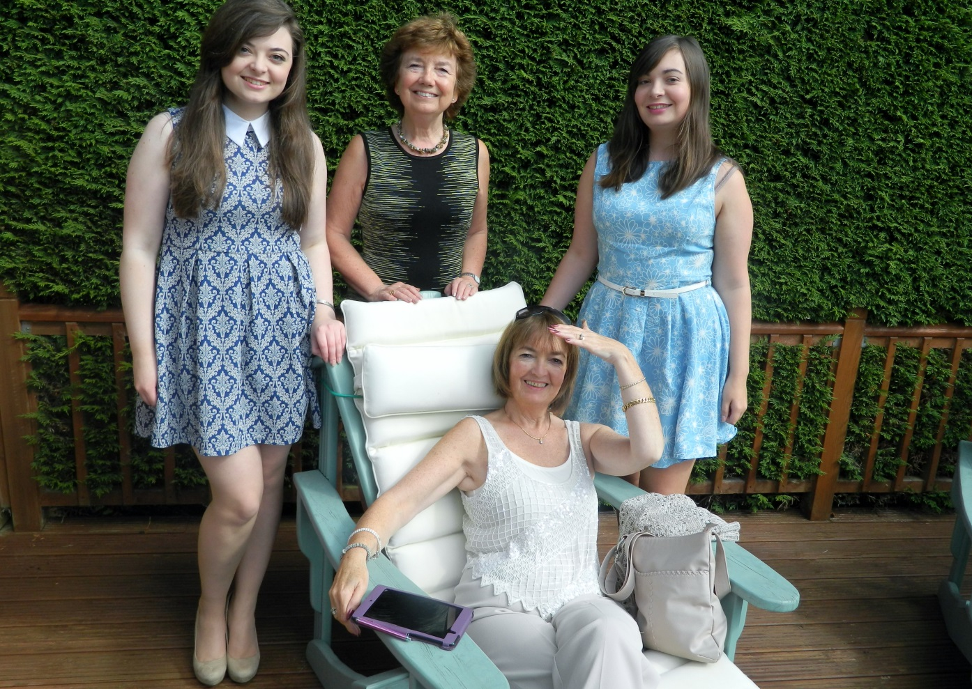
My mum
My mum’s name is Ann.
She is a teacher in a high school.
She has short, brown hair and brown eyes.
Her favourite food is pasta, but she doesn’t like fish.
In her free-time she likes to garden and go out for lunch with her friends.

Slide 5
Activities – A, B and C
A) Reading and Answering questions:
1 – What is Mary Ann’s sister called?
2 – What colour hair does Mary Ann have?
3 – Does Mary Ann have a pet? (You need to ask her)
4 – What type of food does Mary Ann’s mum not like?
5 – What is Mary Ann’s sister’s name?

Slide 6
Activities – A, B and C
B) Speaking and Writing
Prepare a short description of your partner
What colour are their hair and eyes?
What do they like to eat?
What do they do in their free time?
Do they have a pet?
What do they want to be when they are older?

Slide 7
Activities – A, B and C
C) Presenting to class

