Slide 1
A National Festival
St. Andrew’s Day – 30th Novemember

Slide 2
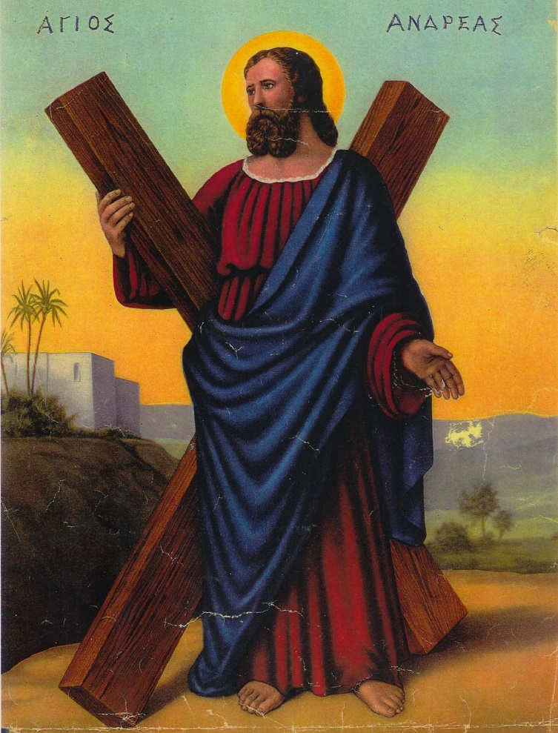
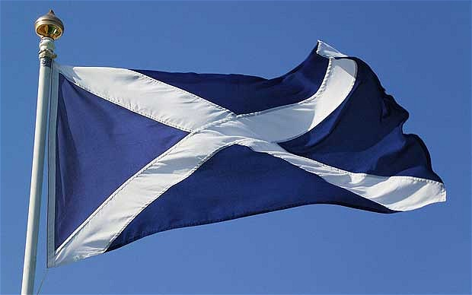
Who is St. Andrew?
St. Andrew is the patron saint of Scotland.
He is also the saint of:
Romania, Russia, Greece, Poland, Ukraine
He was a fisherman and one of the 12 apostles.
When he was crucified his cross was X-shaped, and that is why the Scottish flag is the Saltire.

Slide 3


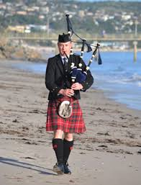
How do we celebrate?
On St. Andrew’s Day businesses and schools are closed.
People spend time with their families.
They also go to special events called Ceilidhs where people dance traditional dances and sing Scottish songs.

Slide 4
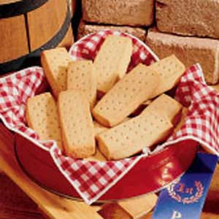
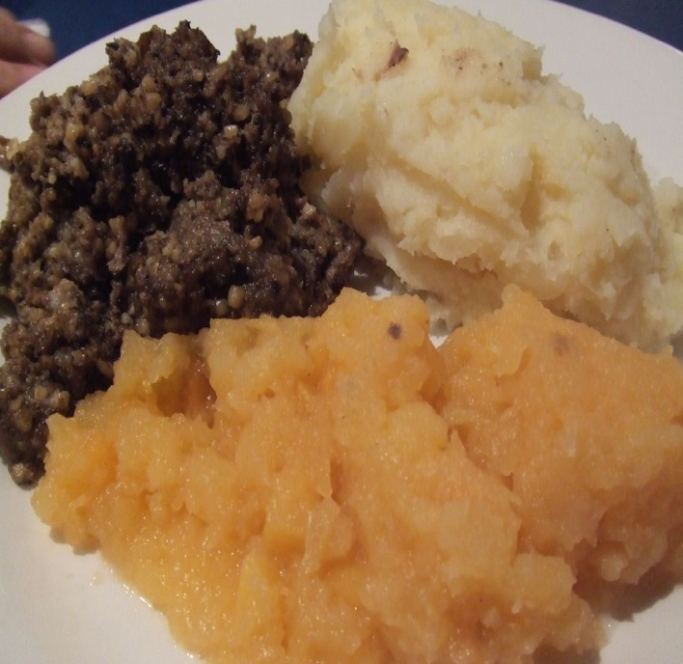
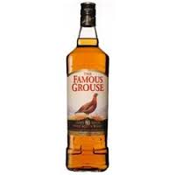
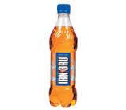
Scottish food
They eat Scottish food such as haggis, neeps and tatties or shortbread.
They also drink Scottish drinks like whiskey and Irn-Bru.

Slide 5
Scottish National Anthem
My country doesn’t have an official national anthem, but when we need to use one then we sing “Oh Flower of Scotland”
We are going to learn the chorus.

Slide 6

Homework
Describe a traditional festival from your country using the frames.
If you need any help ask Mary Ann or Gemma .

