Slide 1
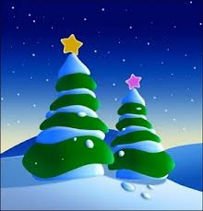
WHAT DO WE LOVE ABOUT CHRISTMAS?

Slide 2

What do we love about Christmas;
Does our delight reside in things?

Slide 3
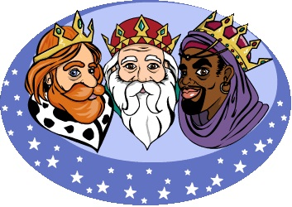
Or are the feelings in our hearts
The real gift that Christmas brings

Slide 4
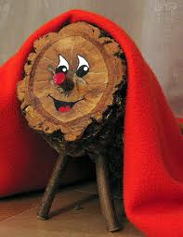
It’s seeing those we love ,
And sending Christmas cards ,too,

Slide 5
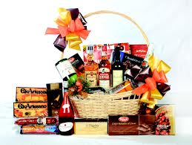
Appreciating people who bring us joy
Special people just like you.

