Slide 1
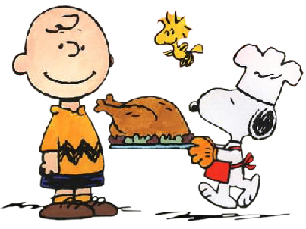
Thanksgiving

Slide 2
What is Thanksgiving?
Thanksgiving is a holiday that is known as a harvest festival.
The theme behind the celebration is being grateful or thankful.
People thank God for a big harvest, and also their family and friends for support and care.

Slide 3
When and Where is Thanksgiving celebrated?
Thanksgiving is celebrated in the United States
It occurs on the fourth (last) Thursday in November, so the date is different every year. This year it is on November 24th 2011.

Slide 4
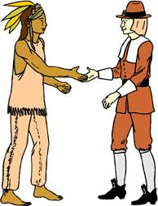
Why did Thanksgiving begin?
Americans say the "First Thanksgiving" was celebrated to give “thanks” to God for guiding the pilgrims safely to the New World in 1620.
The first Thanksgiving feast lasted three days, with food for 53 pilgrims and 90 Native Americans. The Indians taught the pilgrims how to grow crops and survive.
They ate fish, turkey, fruit, and
vegetables (pumpkin, corn, squash).

Slide 5
Traditions
Everyone at the dinner table goes around and says what they are thankful for…
Americans eat turkey, stuffing, mashed potatoes, pumpkin pie, and cranberry sauce…
Watching American football on Thanksgiving or Thanksgiving weekend…
Go shopping the Friday after Thanksgiving, it is called “Black Friday” and stores usually open very early and have many discounts.

Slide 6
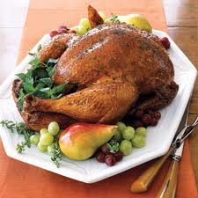
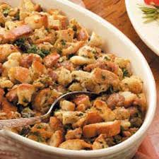
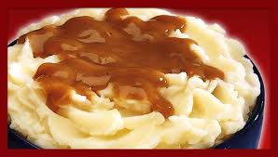
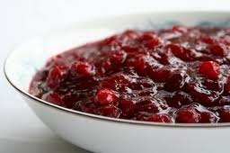
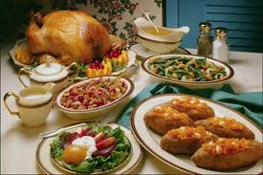
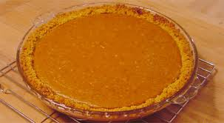
Typical Thanksgiving food
fdfdfdzgz

Slide 7
