Slide 1
PRESENT SIMPLE: MORE THINGS

Slide 2
SUMMARIES: FORM AND USE

Slide 3
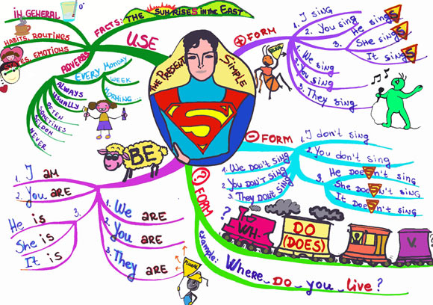

Slide 4
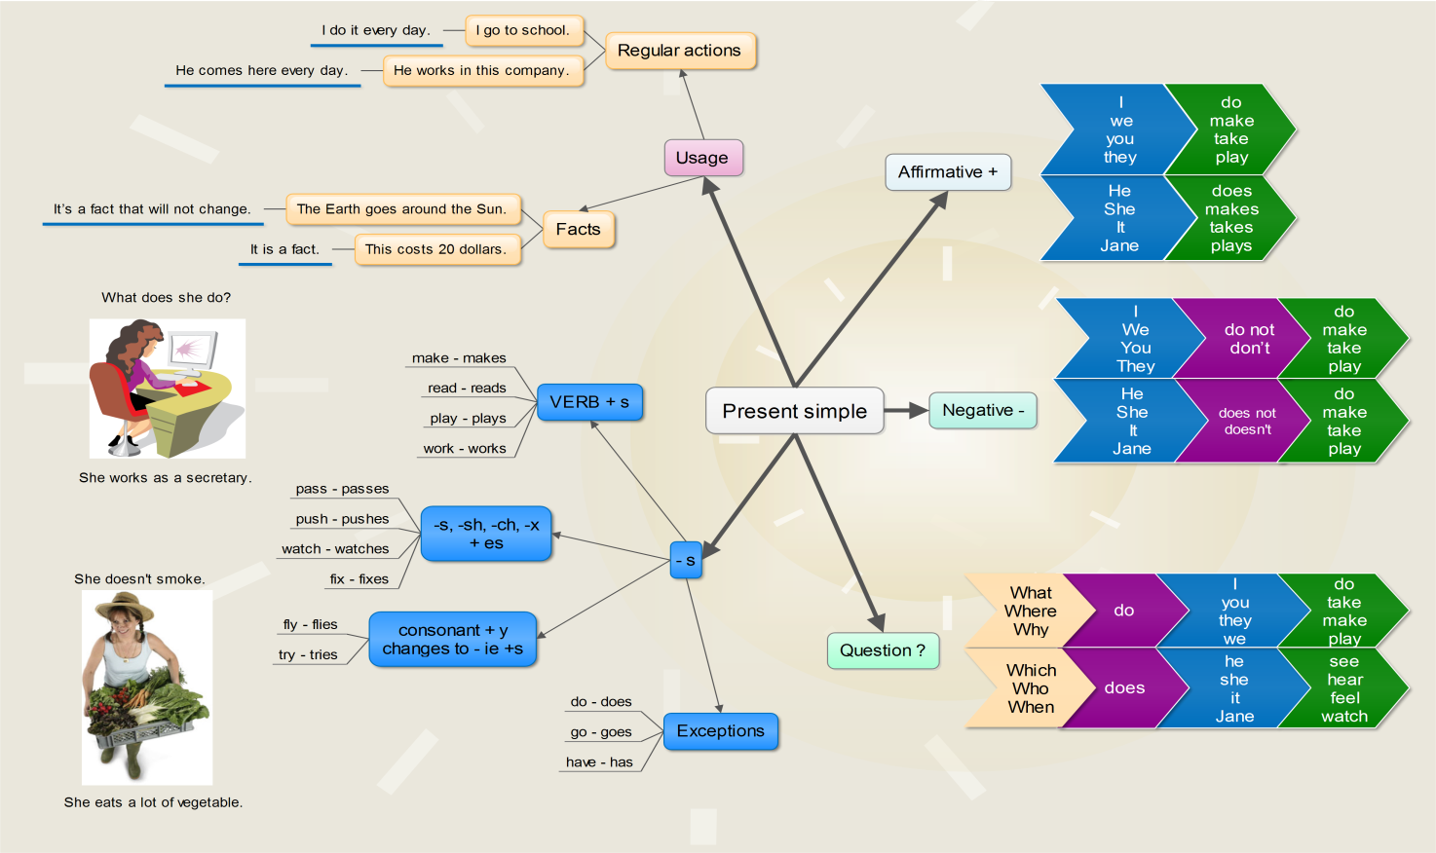

Slide 5
WORD ORDER

Slide 6
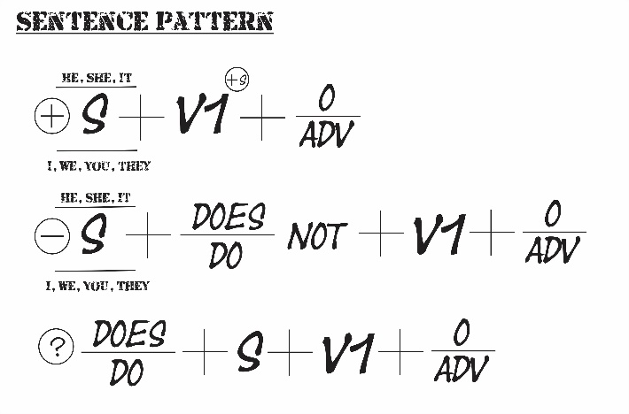
AFFIRMATTIVE, NEGATIVE AND INTERROGATIVE

Slide 7
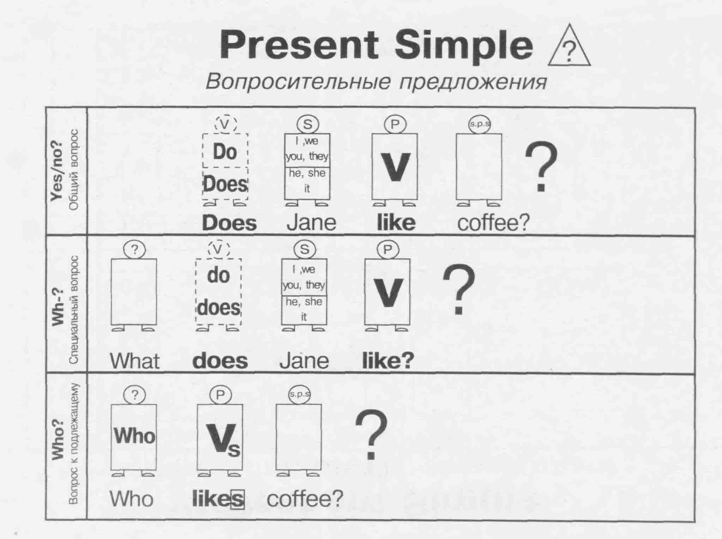
INTERROGATIVE SENTENCES: YES/NO, WH-, WHO SUBECT

Slide 8
FREQUENCY ADVERBS

Slide 9
