Slide 1


Slide 2
                PRESENT SIMPLE:
                FORM

Slide 3
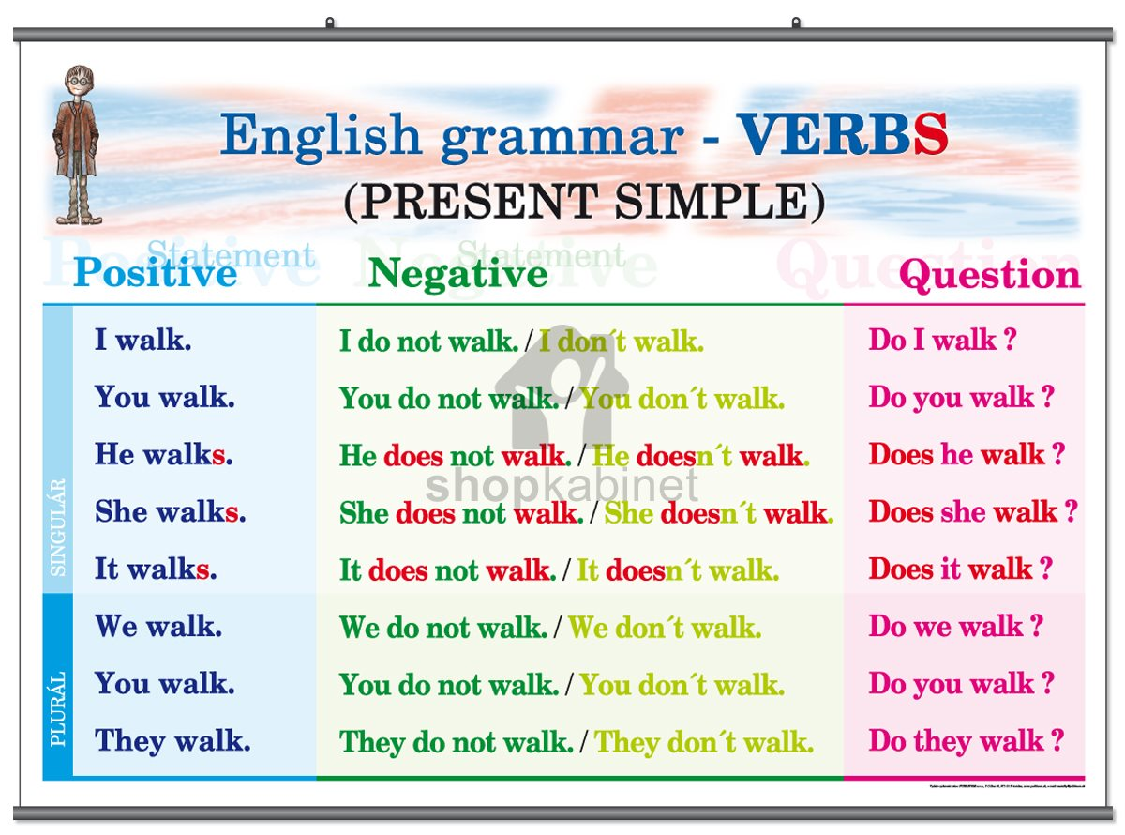

Slide 4
              USE

Slide 5
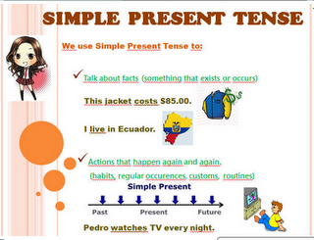

Slide 6


Slide 7
FORM AND USE: SUMMARY

Slide 8
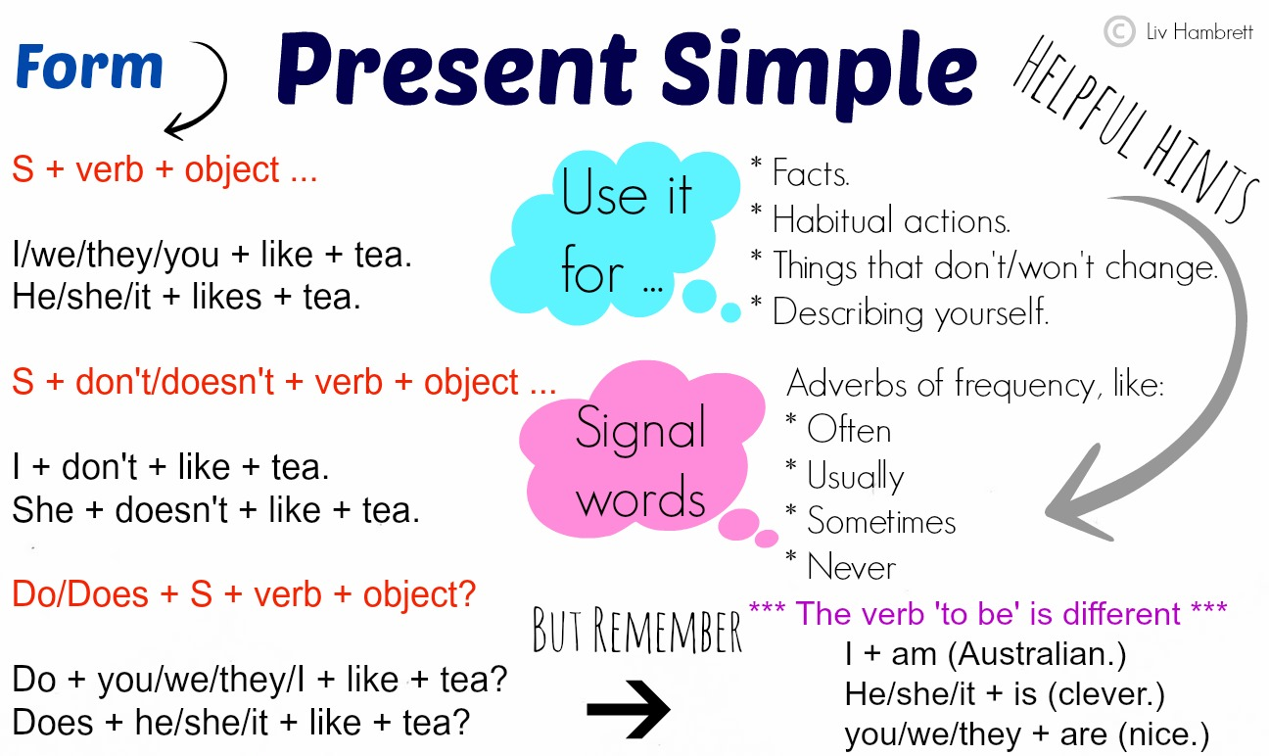

Slide 9
MORE THINGS ABOUT THE PRESENT SIMPLE

Slide 10
