Slide 1

STREET FOOD
EAT ON THE STREET
In many countries, people cook and sell snacks in the street. It’s popular all over the world.

Slide 2
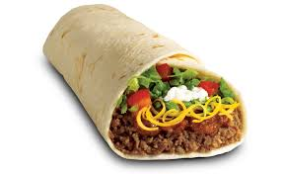
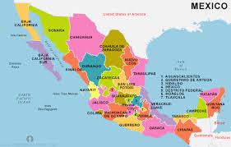
STREET FOOD
In Mexico, people love burritos. They’ve got beef , cheese, tomatoes, onions, salt, pepper and some spices.

Slide 3
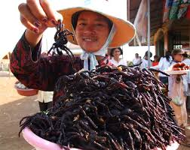
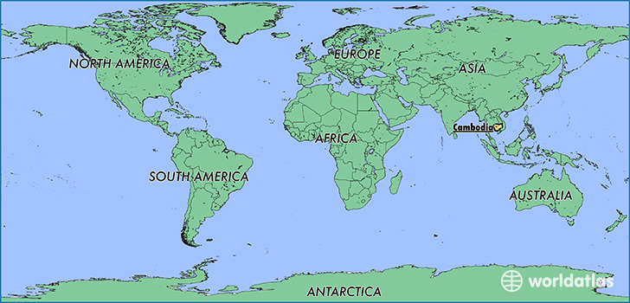
STREET FOOD
In Cambodia, people like spiders. They’re a popular snack. People cook the spiders with oil, salt and sugar.

Slide 4
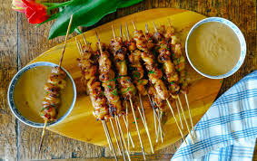
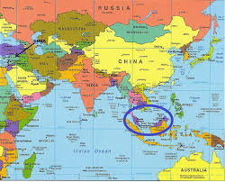
STREET FOOD
In Malaysia, people love chicken satay. It’s got chicken, spices and a stick.

Slide 5
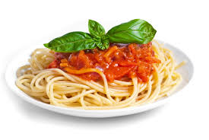
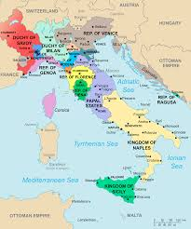
STREET FOOD
In Italy, people love pasta. They eat pasta with tomato, meat, nuts, olives, seafood and cheese.

Slide 6
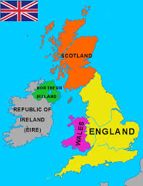
What food is a popular street food in the UK?

