Slide 1
Alhambra de granada
ERIC, NURIA,PAULA,MILOUD

Slide 2
introduction
We are going to introduce you the Alhambra, which is a very famous landmark in Granada.
It consists of a set of palaces, gardens and fortress.

Slide 3
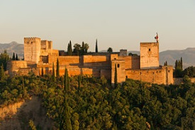
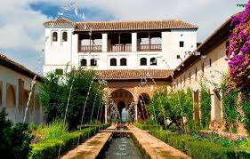

Slide 4
DETAILS
The door of arms is the oldest.
Its construction is a copy of the Roman Baths.
At one end of the left-hand side of the Arrayanes courtyard, a small arch serves as entrance to a passageway leading to the monarch's private area, the Harem (Haram means private place), the so-called Lions palace.

Slide 5
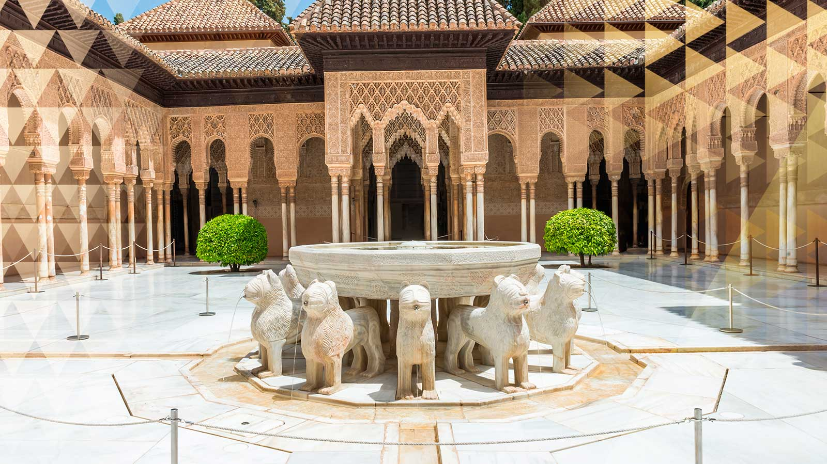
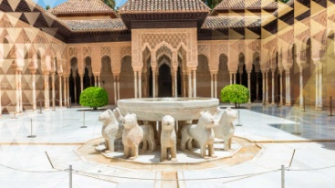
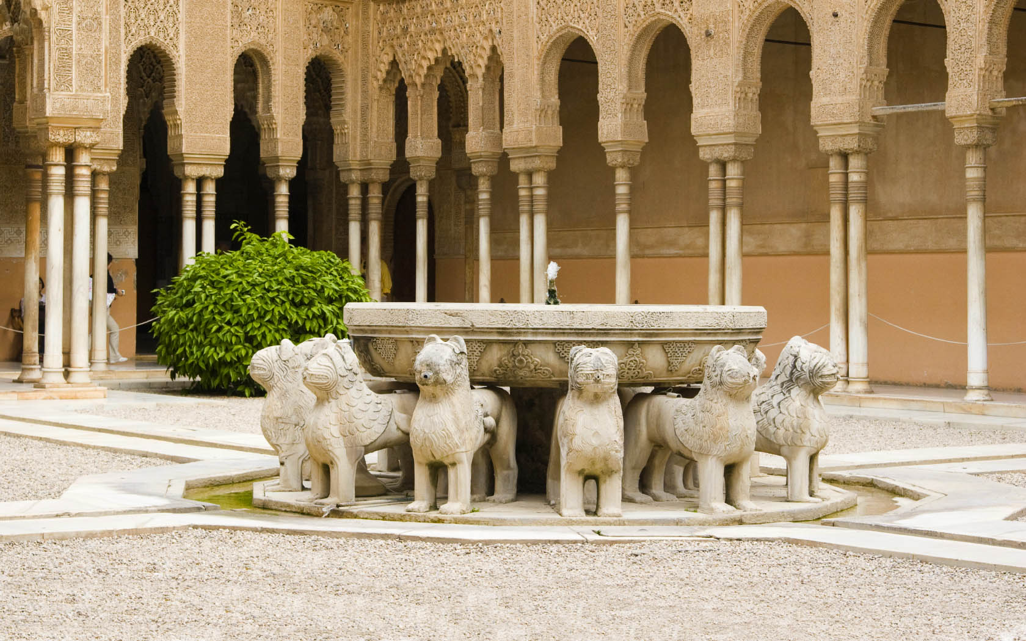

Slide 6
FUN FACTS
In 2015 it was one of the most visited monuments in Spain.
In the middle of the XI century, when Granada became capital of the kingdom of Taifa, under the ziríes dynasty, the constructions were extended.

Slide 7
PHOTO CREDIT
Google

