Slide 1

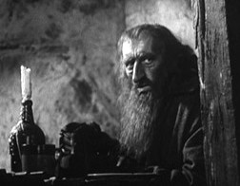
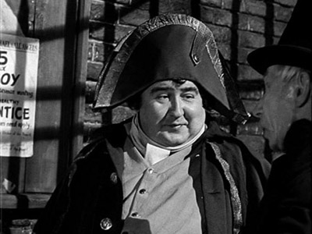
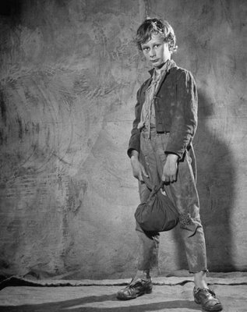
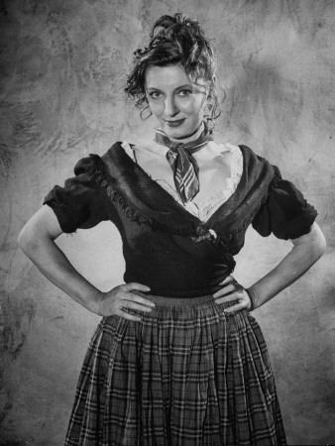
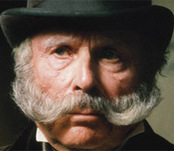
OLIVER TWIST CHARLES DICKENS

Slide 2
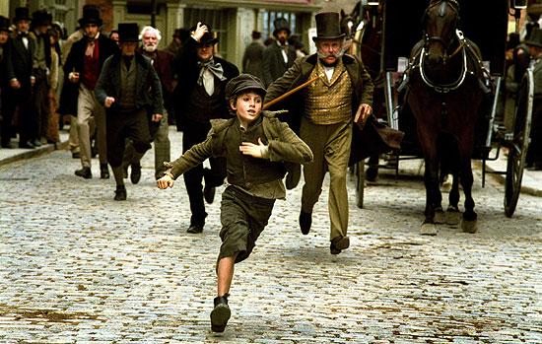
TRAILER
http://www.youtube.com/watch?v=xpYVXdpm6zg

Slide 3
SYNOPSIS
Oliver is a boy from an orphanage, but one day, the director of the orphanage gives Oliver a family, and he has the housework of the house of the family. The family treated badly Oliver and he decides escape to London. In London meets a boy and he goes with him. This boy lives in a house with other children and a gentleman, Fagin. Fagin gives work to Oliver, this work consist to rob the rich people. Oliver the next day robs a man and the police arrested him. In court, a gentleman, Mr. Brownlow helps Oliver and goes to his home. In the house of Mr. Brownlow tracts Oliver very good, but one day, Oliver goes a place, and the children of Fagin kidnap Oliver. Fagin is a very bad man. Mr. Brownlow is concerned for Oliver, and asks help. Nancy a prostitute, that knows where is Oliver says where is to Mr. Brownlow, but then Fagin kills Nancy. Finally Fagin is arrested for the police, and Mr. Brownlow adopts Oliver.

Slide 4
DESCRIPTION OF MAIN CHARACTERS
Oliver Twist →The novel’s protagonist. Oliver is an orphan born in a workhouse, and Dickens uses his situation to criticize public policy toward the poor in 1830s England. Oliver is between nine and twelve years old when the main action of the novel occurs. Though treated with cruelty and surrounded by coarseness for most of his life, he is a pious, innocent child, and his charms draw the attention of several wealthy benefactors. His true identity is the central mystery of the novel.
Fagin →A conniving career criminal. Fagin takes in homeless children and trains them to pick pockets for him. He is also a buyer of other people’s stolen goods. He rarely commits crimes himself, preferring to employ others to commit them—and often suffer legal retribution—in his place. Dickens’s portrait of Fagin displays the influence of anti-Semitic stereotypes.

Slide 5
DESCRIPTION OF MAIN CHARACTERS
Nancy →A young prostitute and one of Fagin’s former child pickpockets. Nancy is also Bill Sikes’s lover. Her love for Sikes and her sense of moral decency come into conflict when Sikes abuses Oliver. Despite her criminal lifestyle, she is among the noblest characters in the novel.
Mr. Brownlow→A well-off, erudite gentleman who serves as Oliver’s first benefactor. Mr. Brownlow owns a portrait of Agnes Fleming and was engaged to Mr. Leeford’s sister when she died. Throughout the novel, he behaves with compassion and common sense and emerges as a natural leader.
Monks→A sickly, vicious young man, prone to violent fits and teeming with inexplicable hatred. With Fagin, he schemes to give Oliver a bad reputation.

Slide 6
DESCRIPTION OF MAIN CHARACTERS
Bill Sikes →A brutal professional burglar brought up in Fagin’s gang. Sikes is Nancy's pimp and lover, and he treats both her and his dog Bull’s-eye with an odd combination of cruelty and grudging affection. His murder of Nancy is the most heinous of the many crimes that occur in the novel.
Mr. Bumble →The pompous, self-important beadle—a minor church official—for the workhouse where Oliver is born. Though Mr. Bumble preaches Christian morality, he behaves without compassion toward the paupers under his care. Dickens mercilessly satirizes his self-righteousness, greed, hypocrisy, and folly, of which his name is an obvious symbol.

Slide 7
USUAL TOPICS IN DICKENS’ LITERATURE
Social oppression (public social and justice)
Descriptions of English life. How people lived in the nineteenth century.
Wrote about topics of 1770 to 1860.
Crime, child exploitation, theft, handling

Slide 8
TOPICS THE FILM DEALS WITH
The film or novel of Oliver Twist, deals with different topics, usual in the 19th century, in the Victorian times. In the film, we can see child exploitation typical of that time, because many children don’t have a house or a family. We can also see delinquency, because in this time there were many rich people, and many poor people, and then the poor children stole the rich people. Finally we can see kidnapping, because many men kidnapped children and forced them to hard work.

Slide 9
HOW IS YOUR RESEARCH ON CHARLES DICKENS SEEN IN THE FILM
Dickens themes used in the movie:
Child exploitation→ Oliver Twist is taken by a family to do all the work.
Delinquency when Fagin forces him to steal.
Abductions or kidnapping→ Fagin kidnaps Oliver .

Slide 10
HOW IS YOUR RESEARCH ON CHARLES DICKENS SEEN IN THE FILM
Dickens's style is florid and poetic, with a strong comic touch. Comparisons of children orphaned by shareholders or furniture diners with some of his most acclaimed ironies.
He used social class comparisons
Oliver Twist is one of the earliest social novels of the literary history.
What is most striking is the work on various contemporary social evils like child labor or the use of children to commit crimes. Dickens laughs at the hypocrisy of his time with these serious issues with sarcasm and black humor.
Dickens in Oliver Twist can be viewed as comparing two different environments: in the field: all is joy, happiness .. but in the city opposite: delinquency, criminals...

