Slide 1
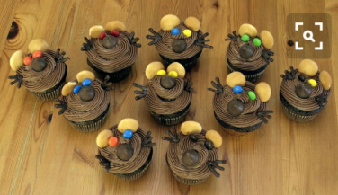
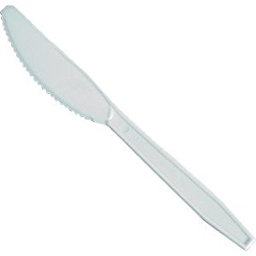
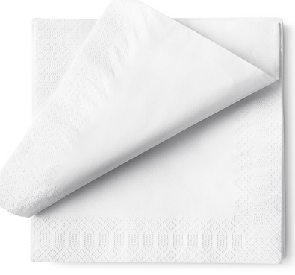
LET’S COOK!
CUPCAKE MOUSE
INGREDIENTS
CUPCAKE
CHOCOLATE
LACASITOS
MINI COOKIES
MIKADOS
BALL CHOCOLATE
COOKING UTENSILS
KNIFE
NAPKIN

Slide 2
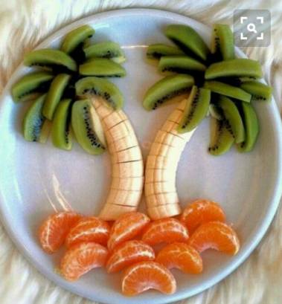
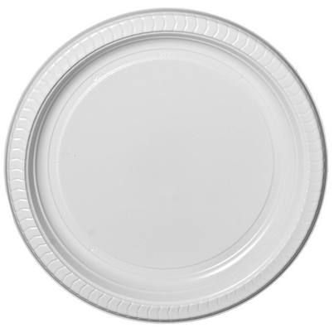
LET’S COOK!
PALM TREE IN A BEACH
INGREDIENTS
BANANA
APPLE
MANDARINE
COOKING UTENSILS
PLATE
KNIFE

