Slide 1

NATURAL SHAPES

Slide 2
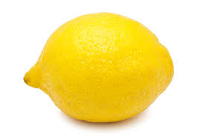
I CAN SEE….
A LEMON

Slide 3
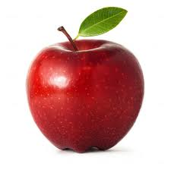
I CAN SEE…
AN APPLE

Slide 4
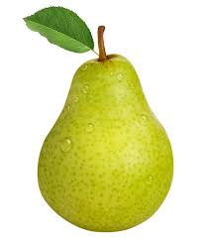
I CAN SEE…
A PEAR

Slide 5
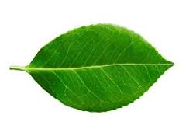
I CAN SEE…
A LEAF

Slide 6
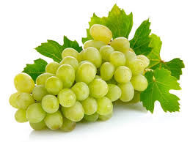
I can see...
GRAPES

Slide 7
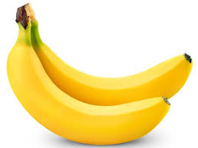
I CAN SEE...
BANANAS

Slide 8
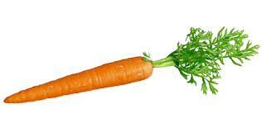
I CAN SEE…
A CARROT

Slide 9

I CAN SEE…
A FLOWER

Slide 10
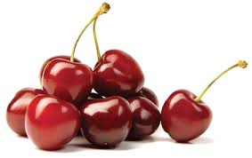
I CAN SEE…
CHERRIES

Slide 11
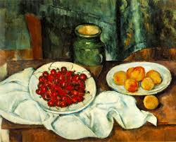
WHAT SHAPES CAN YOU SEE?

Slide 12
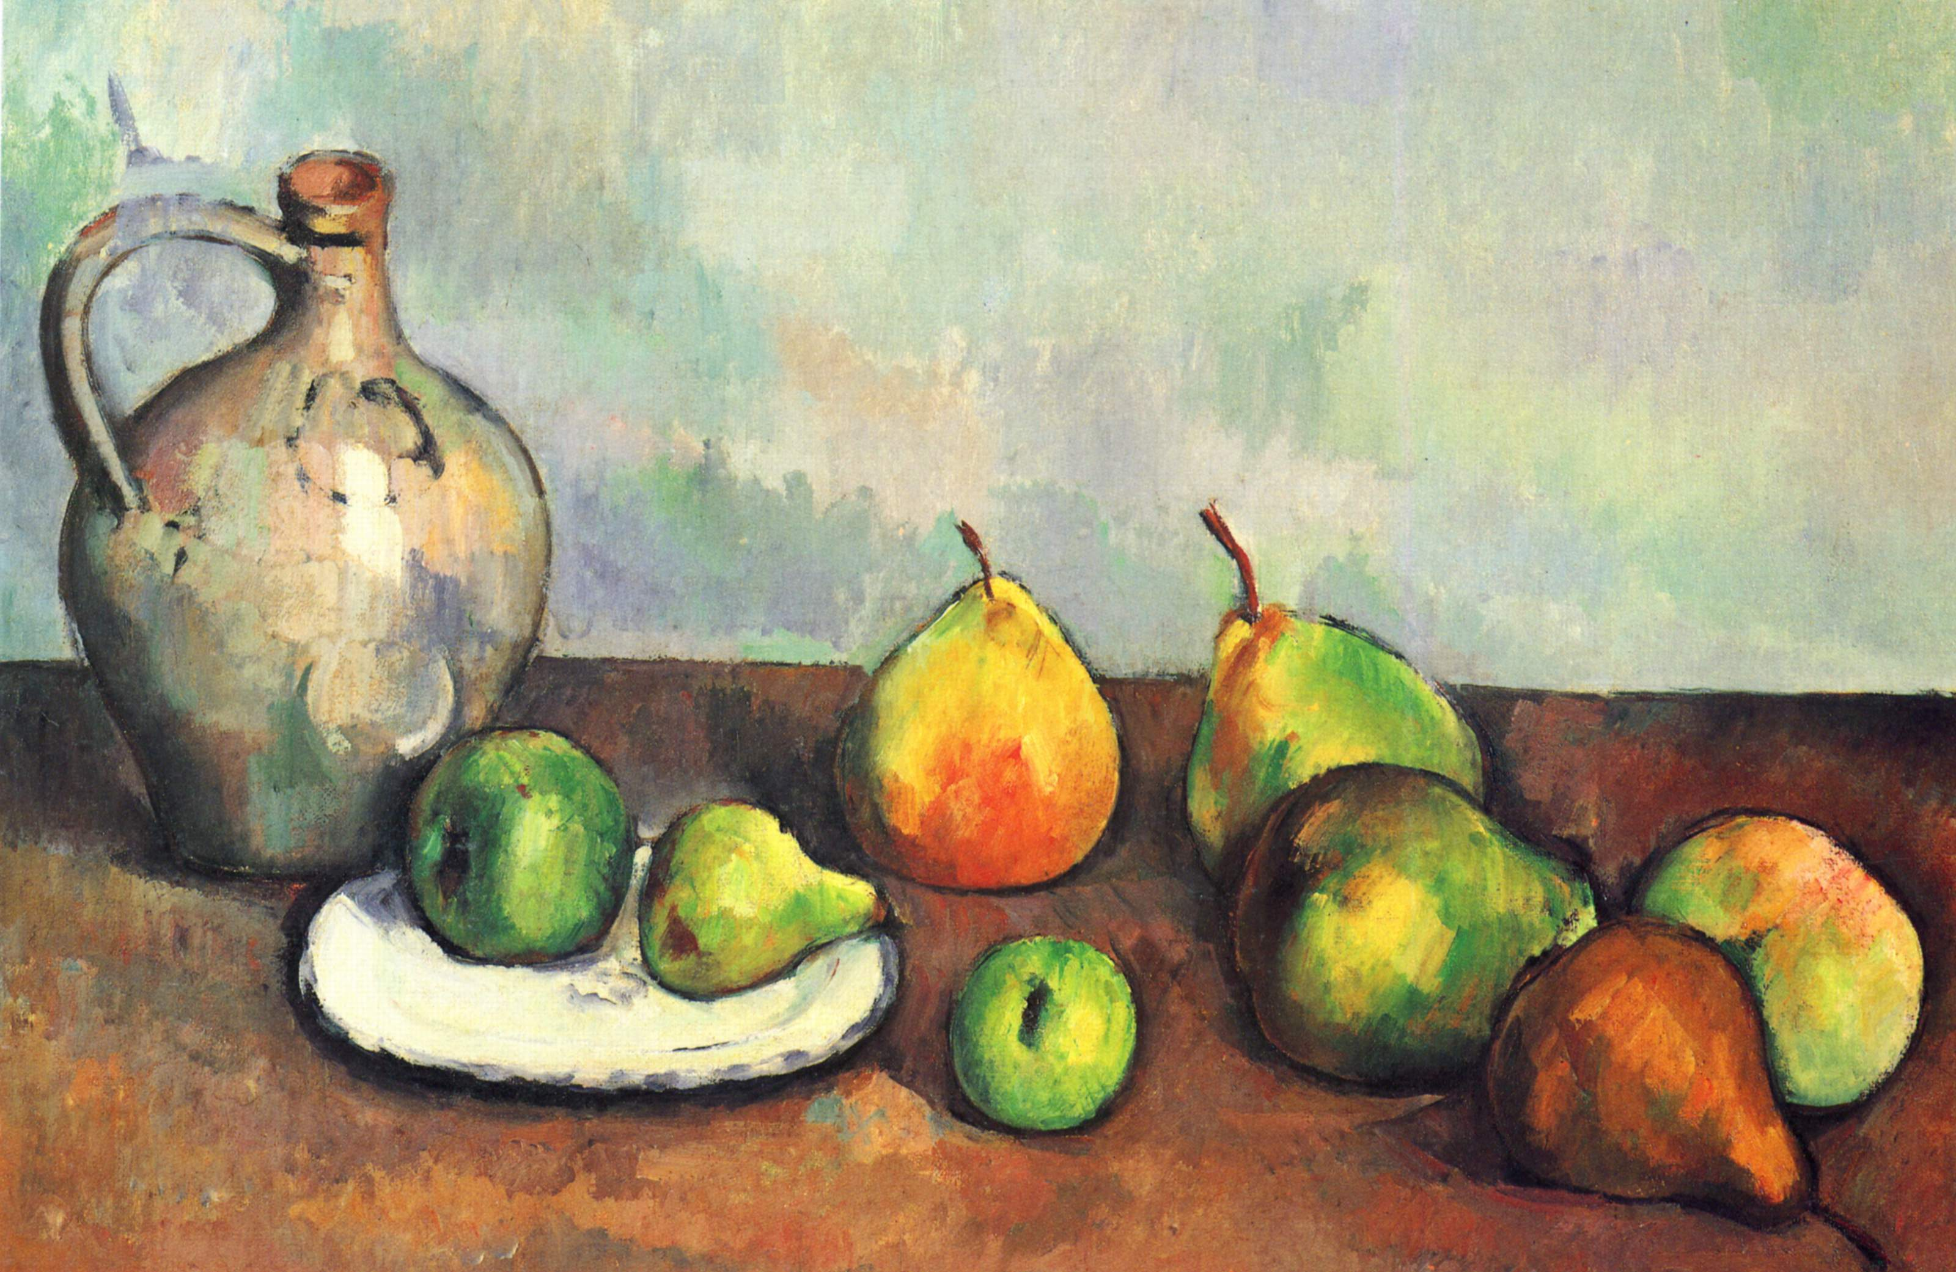
WHAT SHAPES CAN YOU SEE?

