Slide 1

PERSONAL PRONOUNS
A THOUSAND WORDS
2nd CYCLE

Slide 2
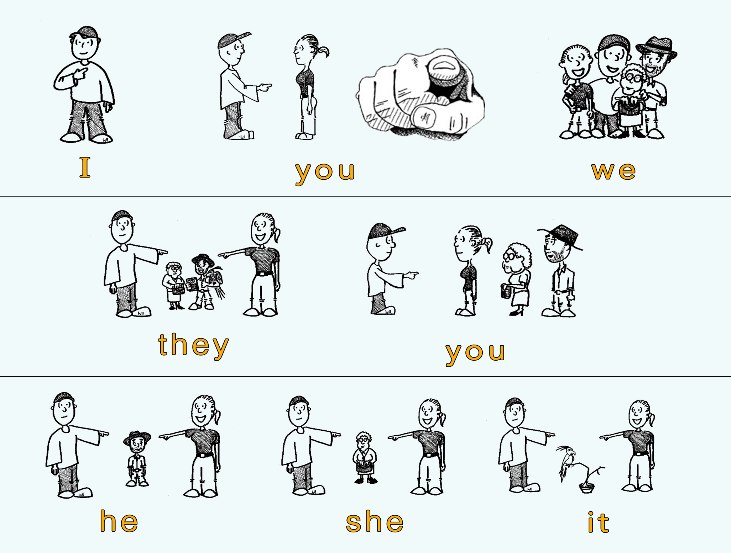

Slide 3
Personal Pronouns
A pronoun is a word that we use in the place of a person, a place, an animal or an idea:
I am from Cambrils JO sóc de Cambrils
You are friends VOSALTRES sou amics
It is my dog “Allò” és el meu gos
It’s a photo of my parents “Allò” és una foto dels meus pares

Slide 4
PERSONAL PRONOUNS
I | JO
YOU | TU
HE | ELL
SHE | ELLA
IT | ALLÒ
WE | NOSALTRES
YOU | VOSALTRES
THEY | ELLS

