Slide 1
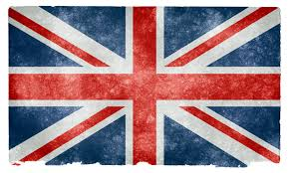
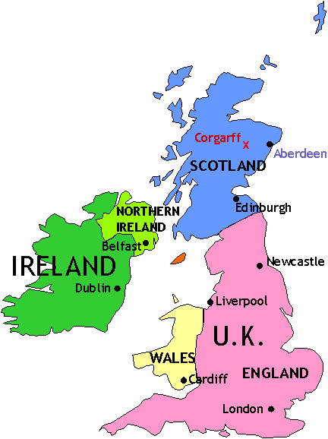
The United Kingdom
Only England, Wales, Scotland, and Northern Ireland are a part of the UK.

Slide 2
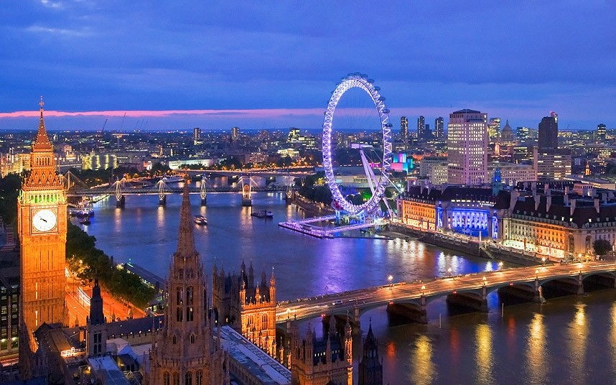
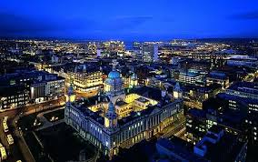
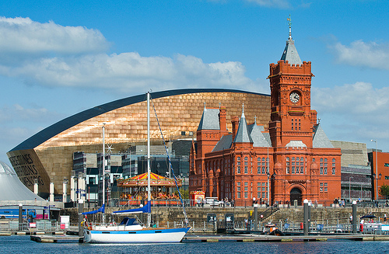
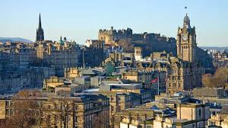
Capital cities
London - England
Belfast – Northern Ireland
Edinburgh - Scotland
Cardiff - Wales

Slide 3
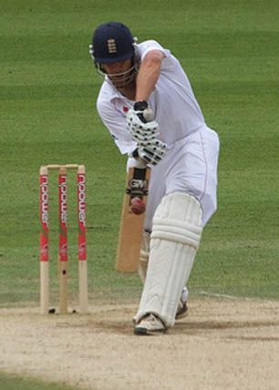
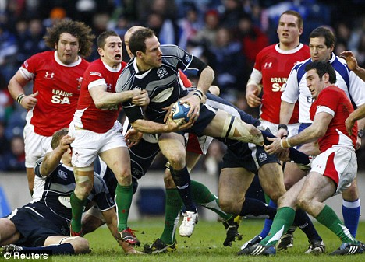
Sports
The most common sports in the UK are:
Football Cricket
Rugby Tennis

Slide 4
Transport in the UK
We have many types of transport, but not all in the same places.
There are only 4 underground train systems in the UK, in London, Liverpool, and 2 in Scotland.
Overground trains connect most places in the UK to each other.
In most places there are buses, but they all look different.
Coaches are like buses for long distances. They don’t stop very often unlike buses because they usually travel to different cities.

Slide 5
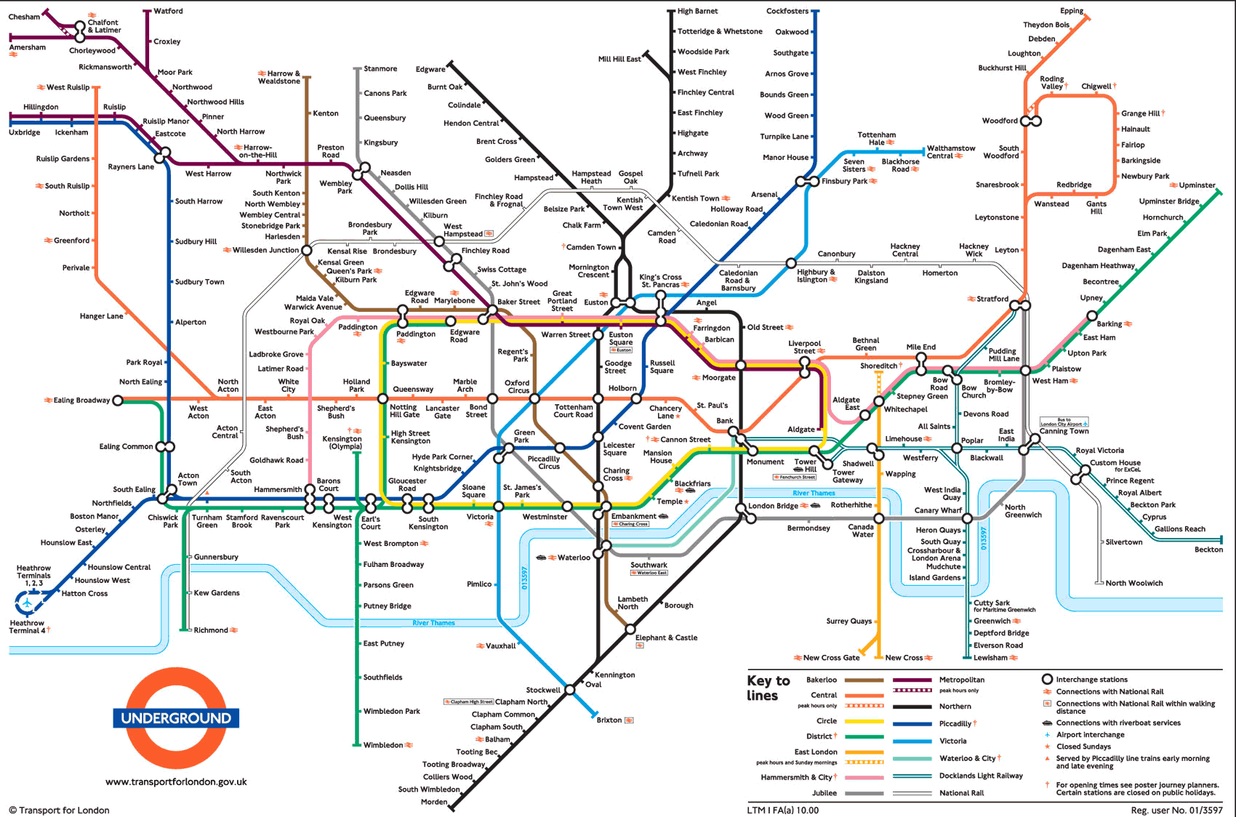
Transport in the UK
London was the first city in the world to have a metro system, it was opened in 1863.
There are 11 lines and 270 stations.

Slide 6
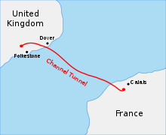
The Channel Tunnel
There is also a tunnel called the Channel Tunnel which connects Southern England to Northern France. It allows trains to travel under the sea, it has the longest undersea portion of tunnel in the world.

Slide 7
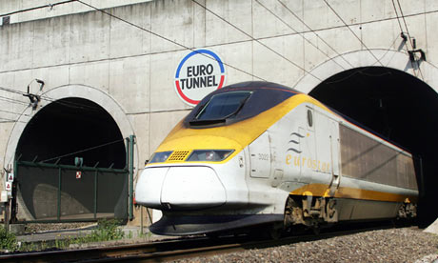
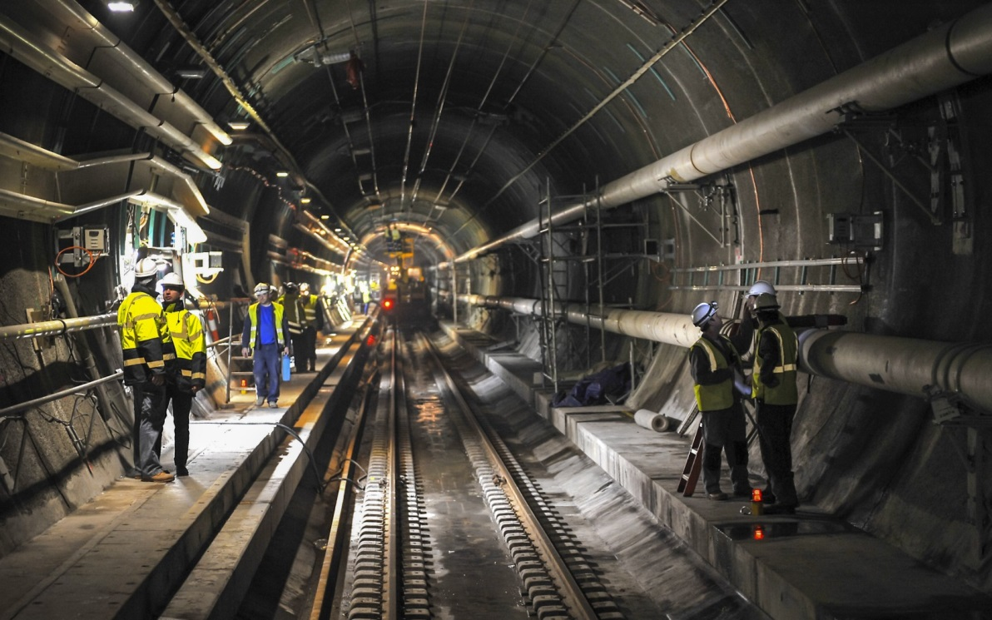
Eurostar
The main train that travels through the Channel Tunnel is called the Eurostar, which connects London with Paris in France, and Brussels in Belgium.

Slide 8
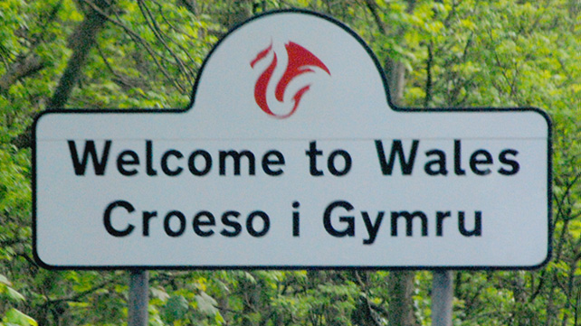
Wales
English is spoken in all 4 countries, but with various accents. However, there is also another official language – Welsh.
Welsh was spoken long before the UK existed, but the majority of the country don’t speak it.

Slide 9
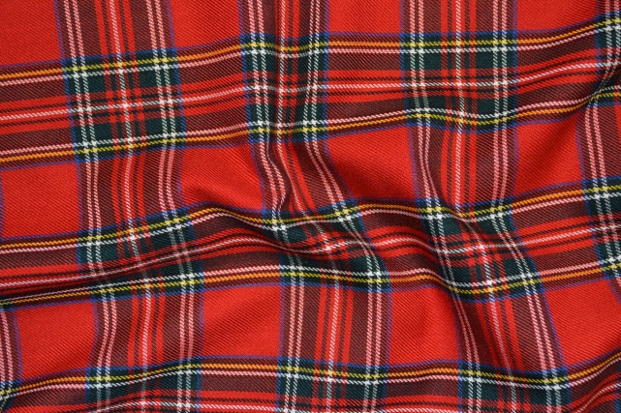
Scotland
Scotland is famous for it’s cultural clothing, a ‘kilt’ which is like a skirt but for men, and the ‘tartan’ pattern.
The kilt is usually worn when using the traditional musical instrument ‘bagpipes’.
https://www.youtube.com/watch?v=ePdmXXA9sP4

Slide 10
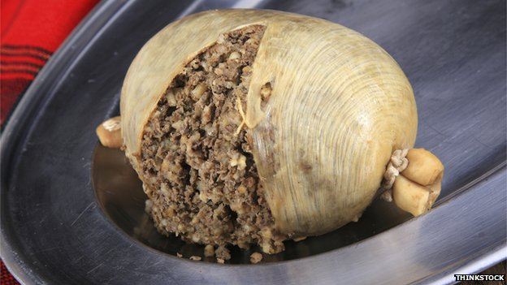
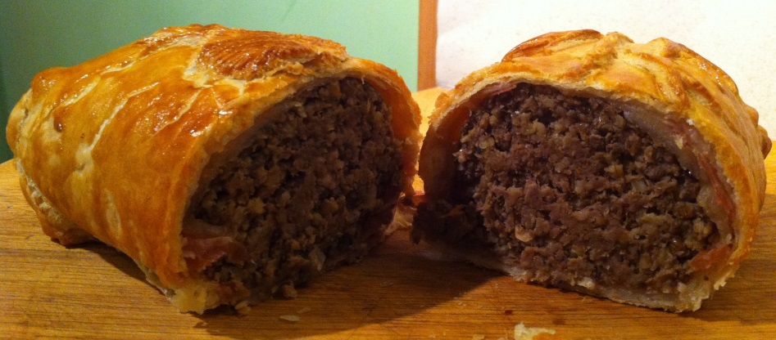
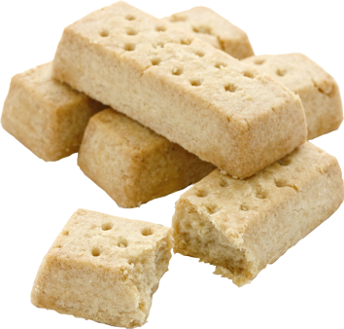
Scotland
The most famous Scottish traditional dish called ‘Haggis’ which is made of a sheep’s heart, liver, and lungs and mixed with onions and spices. It is then stuffed inside an animals stomach.
Also traditionally Scottish is shortbread, which is a type of biscuit made of sugar, butter, and flour.

Slide 11
Northern Ireland
Ireland has a very traditional type of dance called Irish dance, it looks like this:
https://www.youtube.com/watch?v=69AMMX5_0j8
Ireland is not on the same island as Scotland, England, and Wales.

