Slide 1
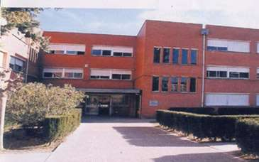
Educational System in Catalonia, Spain

Slide 2
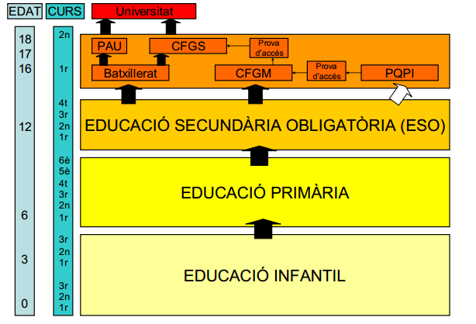
AGE
GRADE
University
College
COMPULSORY SECONDARY EDUCATION
Up to 16
PRIMARY EDUCATION
EARLY AGES
EARLY AGES

Slide 3
School Year
The school year is divided into three terms with a long summer holiday break of almost three months
- Winter term (September to December).
- Spring term (January to Easter).
- Summer term (After Easter to late June).
• The school day for primary schools can vary but is normally from 09.00 – 12.00 and 15.00 – 17.00.
• For ESO or Bachillerato, the school day is usually from 08.00 – 15.00 or 08.30 – 14.00 and 15.30 - 17.30 (1/2 days a week).

Slide 4
Catalan School Curriculum
1rst, 2nd and 3rd ESO Grades
Science
History and Geography
Sports
Citizenship
Arts and Crafts
Catalan Language
Spanish Language
Foreign Language (English or French)
Mathematics
Music
Technologies
Tutor Sessions
Catholic religion (not compulsory)
Optional Subject
Second foreign language
Classical culture
Others offered by each school
4th ESO Grade
History and Geography
Sports
Citizenship
Catalan Language
Spanish Language
Foreign Language (English or French)
Mathematics
Tutor Sessions
Catholic religion (not compulsory)
The students choose three of the following subjects
Biology and Geology
Arts and Crafts
Physics and Chemistry
IT (Information Technology)
Latin
Music
Second Foreign Language
Technology

Slide 5
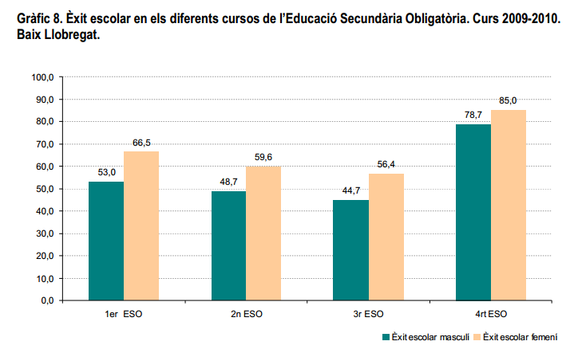
School success by gender

Slide 6
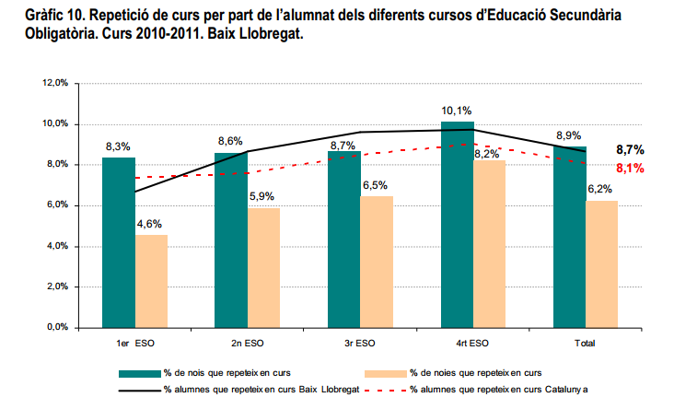
Rate of repeaters in compulsory
Secondary Education

Slide 7
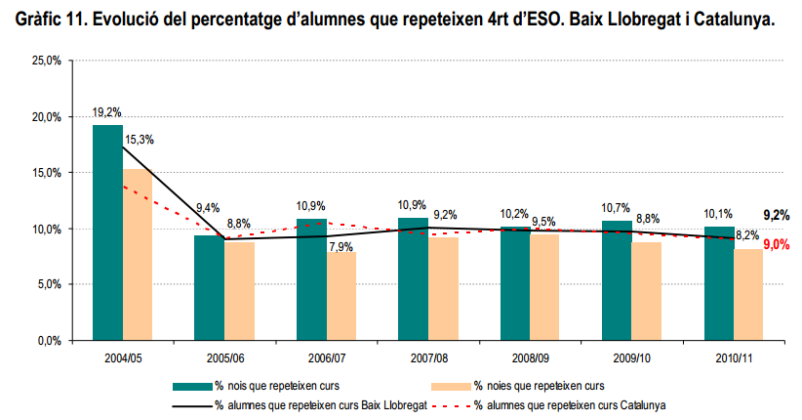
Rate of repeaters at the end of
compulsory Secondary Education

Slide 8
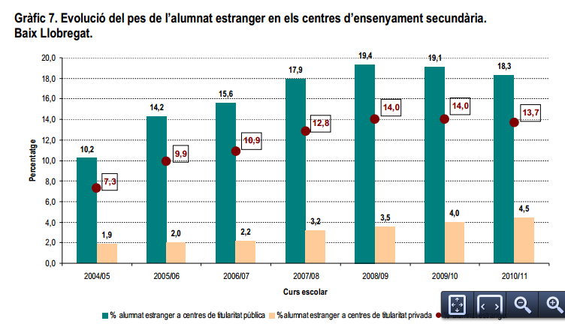
Rate of foreign students

Slide 9
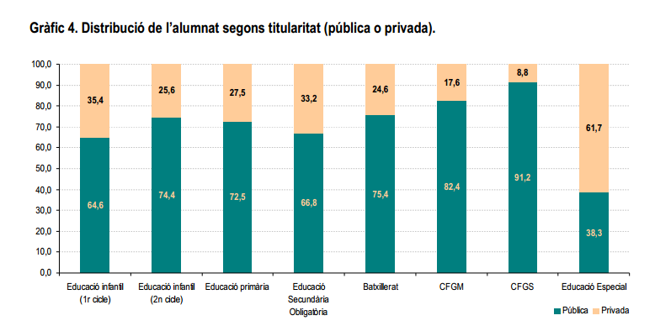
Distribution of students between public or private schools

